Slide 1
Resource Allocation and Trajectory
Optimization for UAV-Enabled
Multi-User Covert Communications
Xu Jiang; Zhutian Yang; Nan Zhao; Yunfei Chen; Zhiguo Ding; Xianbin Wang
Published in: IEEE Transactions on Vehicular Technology
Date of Publication: 22 January 2021

Slide 2
Table of Contents
01 Abstract
02 Introduction
03 System Model
04 Problem Formulation
05 Covert rate maximization

Slide 3
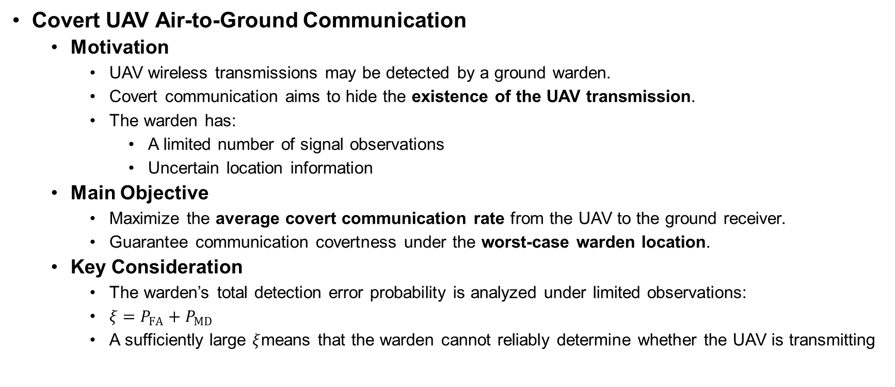
Abstract
Covert UAV Air-to-Ground Communication
  Motivation
    UAV wireless transmissions may be detected by a ground warden.
    Covert communication aims to hide the existence of the UAV transmission.
    The warden has:
      A limited number of signal observations
      Uncertain location information
  Main Objective
    Maximize the average covert communication rate from the UAV to the ground receiver.
    Guarantee communication covertness under the worst-case warden location.
  Key Consideration
    The warden’s total detection error probability is analyzed under limited observations:
    $ξ=P_{FA}+P_{MD}$
    A sufficiently large $ξ$means that the warden cannot reliably determine whether the UAV is transmitting

Slide 4
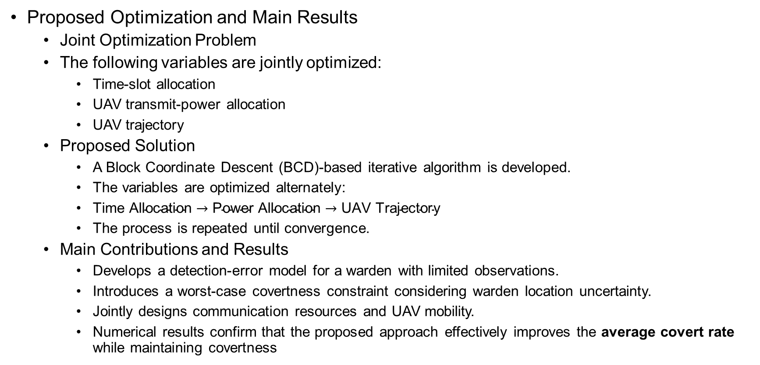
Abstract
Proposed Optimization and Main Results
  Joint Optimization Problem
  The following variables are jointly optimized:
    Time-slot allocation
    UAV transmit-power allocation
    UAV trajectory
  Proposed Solution
    A Block Coordinate Descent (BCD)-based iterative algorithm is developed.
    The variables are optimized alternately:
    $\text{Time} \text{Allocation}→\text{Power} \text{Allocation}→\text{UAV} \text{Trajectory}$
    The process is repeated until convergence.
  Main Contributions and Results
    Develops a detection-error model for a warden with limited observations.
    Introduces a worst-case covertness constraint considering warden location uncertainty.
    Jointly designs communication resources and UAV mobility.
    Numerical results confirm that the proposed approach effectively improves the average covert rate while maintaining covertness

Slide 5
Introduction
UAV-Assisted Wireless Communications
  Advantages of UAV Communications
    Flexible and rapid deployment
    High mobility
    Strong line-of-sight (LoS) air-to-ground channels
    Ability to adjust position according to communication requirements
  Major Applications
    Disaster rescue
    Surveillance
    Data gathering
    Wireless data relaying
    Military communications
  Security Challenge
    Wireless signals are naturally broadcast.
    Strong LoS links make UAV transmissions easier to detect.
    UAV communications are therefore vulnerable to:
      Malicious eavesdroppers
      Terrestrial wardens

Slide 6
Introduction
Physical Layer Security vs. Covert Communication
  Physical Layer Security
    Prevents an eavesdropper from decoding confidential information.
    Security can be improved through:
      UAV transmit-power control
      UAV trajectory optimization
  Limitation of Physical Layer Security
    The adversary may still detect that a transmission is taking place.
    In critical applications, detecting the transmission itself may reveal:
      UAV activity
      Communication location
      Possible military operations
  Covert Communication
    Also known as low probability of intercept communication.
    Its objective is to hide the existence of wireless transmission from the warden.

Slide 7
Introduction
Existing Research on Covert UAV Communications
  Previous Studies
    Analyzed the total detection error probability of UAV transmission.
    Used a UAV as a warden in multi-hop covert communication.
    Jointly optimized UAV transmit power and altitude.
    Jointly optimized UAV transmit power and trajectory.
    Demonstrated that UAV mobility and resource allocation can improve covertness.
  Main Assumptions in Previous Works
    Most studies considered only a single ground user.
    Some studies assumed that the warden had an infinite number of observations in each time slot.
  Research Gap
    Covert UAV communication for multiple ground users remains insufficiently studied.
    The impact of a warden with a limited number of observations must also be considered

Slide 8
Introduction
Considered Multiuser Covert UAV System
  System Scenario
    One UAV transmits confidential information to multiple ground users.
    A terrestrial warden attempts to detect the UAV’s transmission.
    The warden knows the UAV’s exact location.
    The UAV only knows an estimated location of the warden.
  Multiuser Transmission
    Time-Division Multiple Access (TDMA) is adopted.
    Each time slot is assigned to one ground user.
    The UAV can fly closer to the scheduled user to improve its communication rate.
  Robust Covertness Requirement
    Warden-location uncertainty is considered.
    Covertness must be guaranteed under the worst-case possible warden location.

Slide 9
Introduction
Problem Formulation and Proposed Solution
  Optimization Objective
    Maximize the worst-case average covert communication rate by jointly optimizing:
      Time-slot allocation
      UAV transmit-power allocation
      UAV flight trajectory
  Main Challenge
    The joint optimization problem is non-convex.
    The optimization variables are strongly coupled through:
      Communication-rate constraints
      Covertness constraints
      UAV mobility constraints

Slide 10
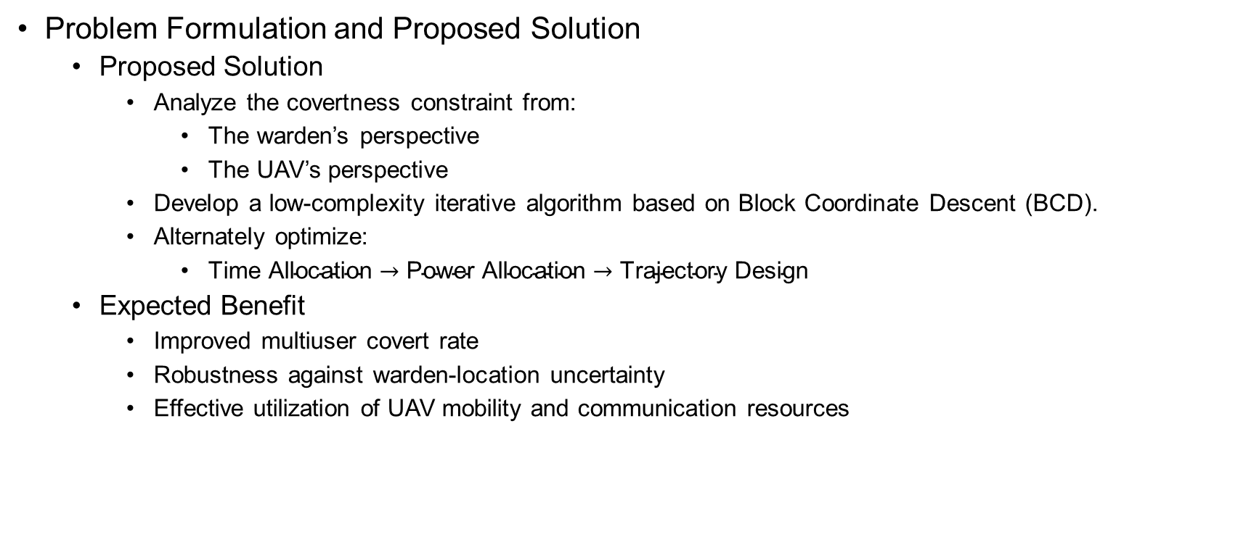
Introduction
Problem Formulation and Proposed Solution
  Proposed Solution
    Analyze the covertness constraint from:
      The warden’s perspective
      The UAV’s perspective
    Develop a low-complexity iterative algorithm based on Block Coordinate Descent (BCD).
    Alternately optimize:
      $\text{Time} \text{Allocation}→\text{Power} \text{Allocation}→\text{Trajectory} \text{Design}$
  Expected Benefit
    Improved multiuser covert rate
    Robustness against warden-location uncertainty
    Effective utilization of UAV mobility and communication resources

Slide 11
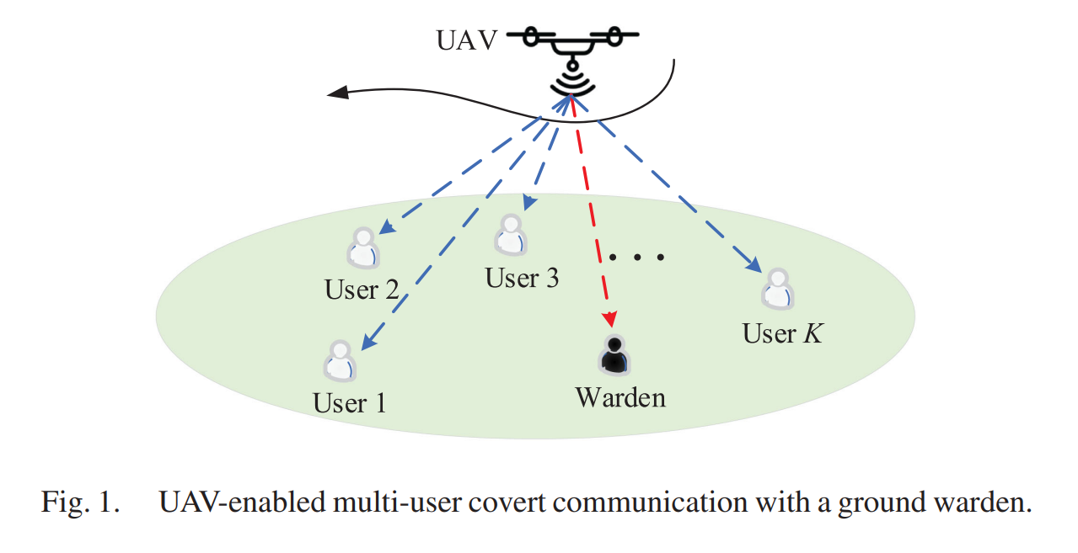
System Model

Slide 12
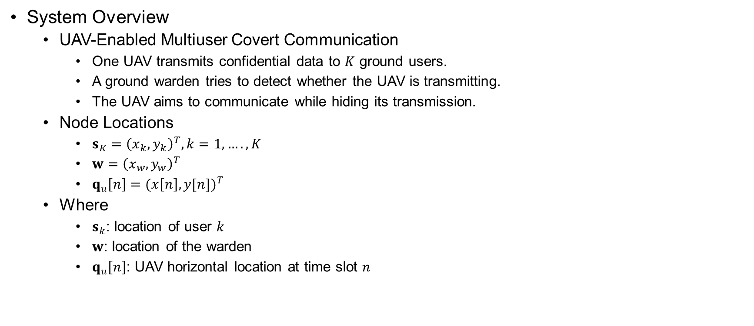
System Model
System Overview
  UAV-Enabled Multiuser Covert Communication
    One UAV transmits confidential data to $K$ ground users.
    A ground warden tries to detect whether the UAV is transmitting.
    The UAV aims to communicate while hiding its transmission.
  Node Locations
    $s_{K}={\left(x_{k},y_{k}\right)}^{T}, k=1,….,K$
    $w={\left(x_{w},y_{w}\right)}^{T}$
    $q_{u}\left[n\right]={(x\left[n\right],y[n])}^{T}$
  Where
    $s_{k}$: location of user $k$
    $w$: location of the warden
    $q_{u}\left[n\right]$: UAV horizontal location at time slot $n$

Slide 13
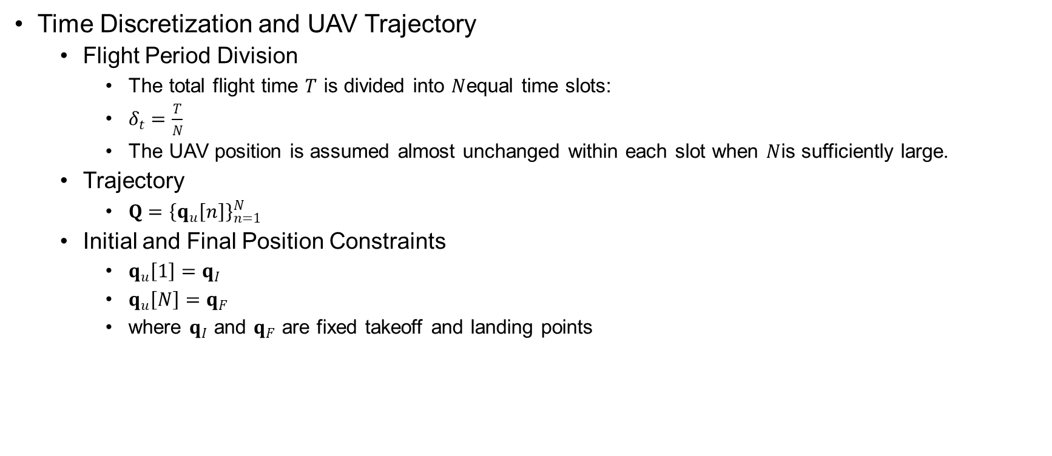
System Model
Time Discretization and UAV Trajectory
  Flight Period Division
    The total flight time $T$ is divided into $N$equal time slots:
    $δ_{t}=\frac{T}{N}$
    The UAV position is assumed almost unchanged within each slot when $N$is sufficiently large.
  Trajectory
    $Q={\left\{q_{u}\left[n\right]\right\}}_{n=1}^{N}$
  Initial and Final Position Constraints
    $q_{u}\left[1\right]=q_{I}$
    $q_{u}\left[N\right]=q_{F}$
    where $q_{I}$ and $q_{F}$ are fixed takeoff and landing points

Slide 14
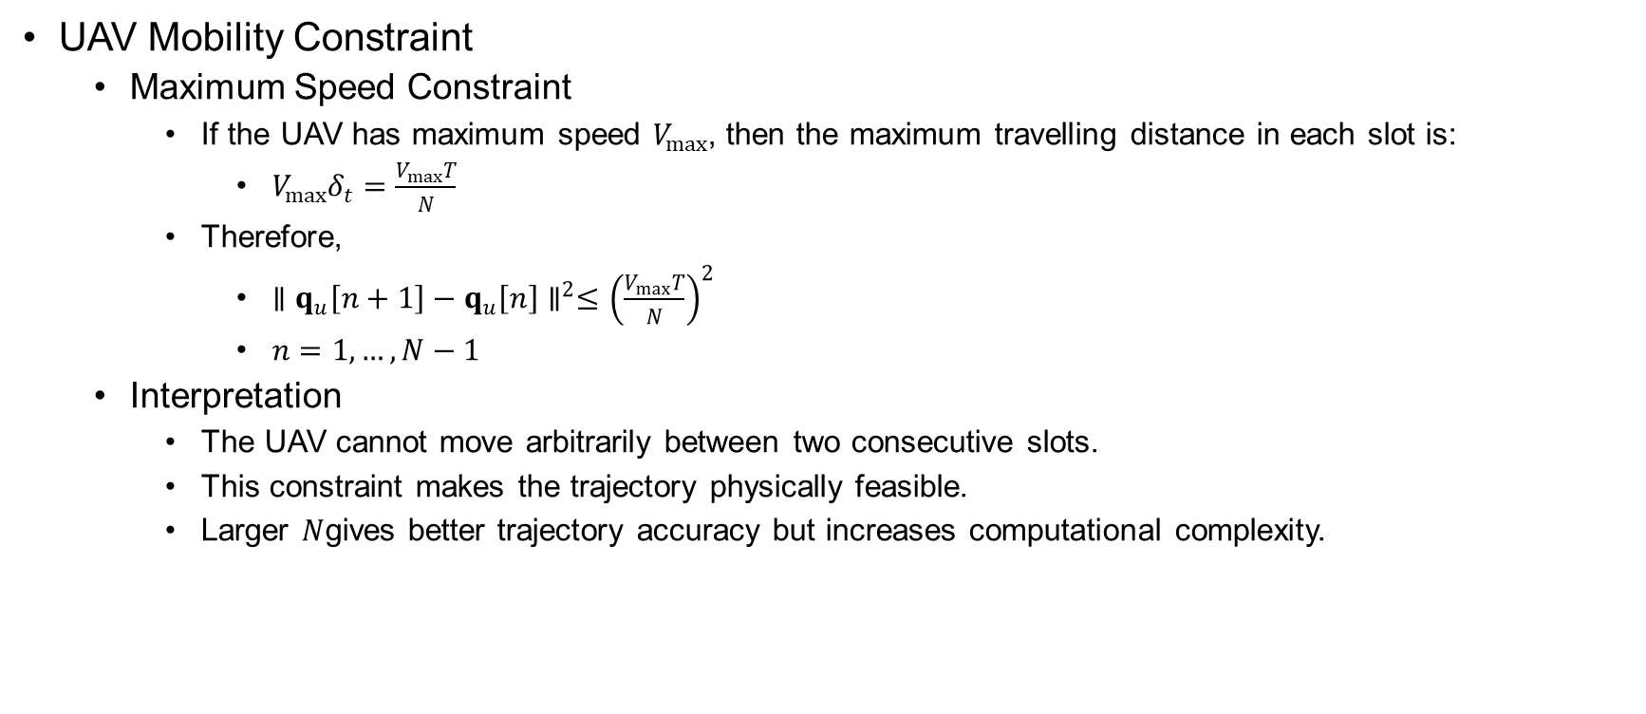
System Model
UAV Mobility Constraint
  Maximum Speed Constraint
    If the UAV has maximum speed $V_{max}$, then the maximum travelling distance in each slot is:
      $V_{max}δ_{t}=\frac{V_{max}T}{N}$
    Therefore,
      $∥q_{u}\left[n+1\right]−q_{u}\left[n\right]∥^{2}≤{\left(\frac{V_{max}T}{N}\right)}^{2}$
      $n=1,…,N−1$
  Interpretation
    The UAV cannot move arbitrarily between two consecutive slots.
    This constraint makes the trajectory physically feasible.
    Larger $N$gives better trajectory accuracy but increases computational complexity.

Slide 15
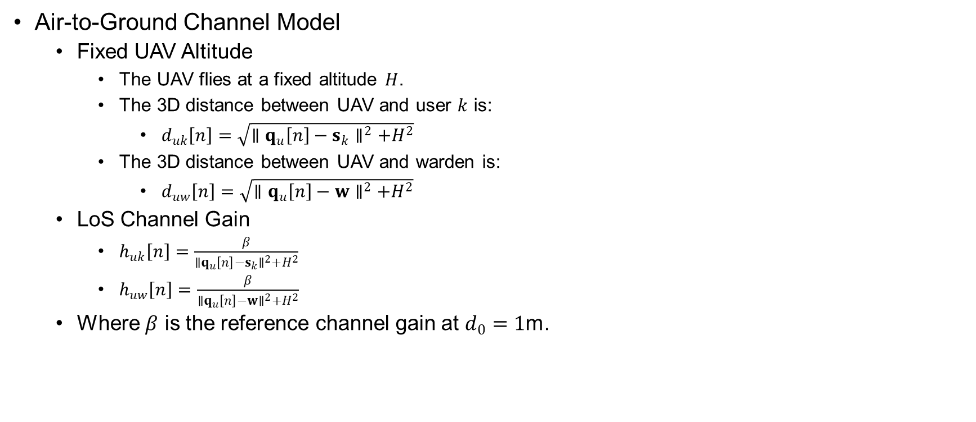
System Model
Air-to-Ground Channel Model
  Fixed UAV Altitude
    The UAV flies at a fixed altitude $H$.
    The 3D distance between UAV and user $k$ is:
      $d_{uk}\left[n\right]=\sqrt{∥q_{u}\left[n\right]−s_{k}∥^{2}+H^{2}}$
    The 3D distance between UAV and warden is:
      $d_{uw}\left[n\right]=\sqrt{∥q_{u}\left[n\right]−w∥^{2}+H^{2}}$
  LoS Channel Gain
    $h_{uk}\left[n\right]=\frac{β}{∥q_{u}\left[n\right]−s_{k}∥^{2}+H^{2}}$
    $h_{uw}\left[n\right]=\frac{β}{∥q_{u}\left[n\right]−w∥^{2}+H^{2}}$
  Where $β$ is the reference channel gain at $d_{0}=1$m.

Slide 16
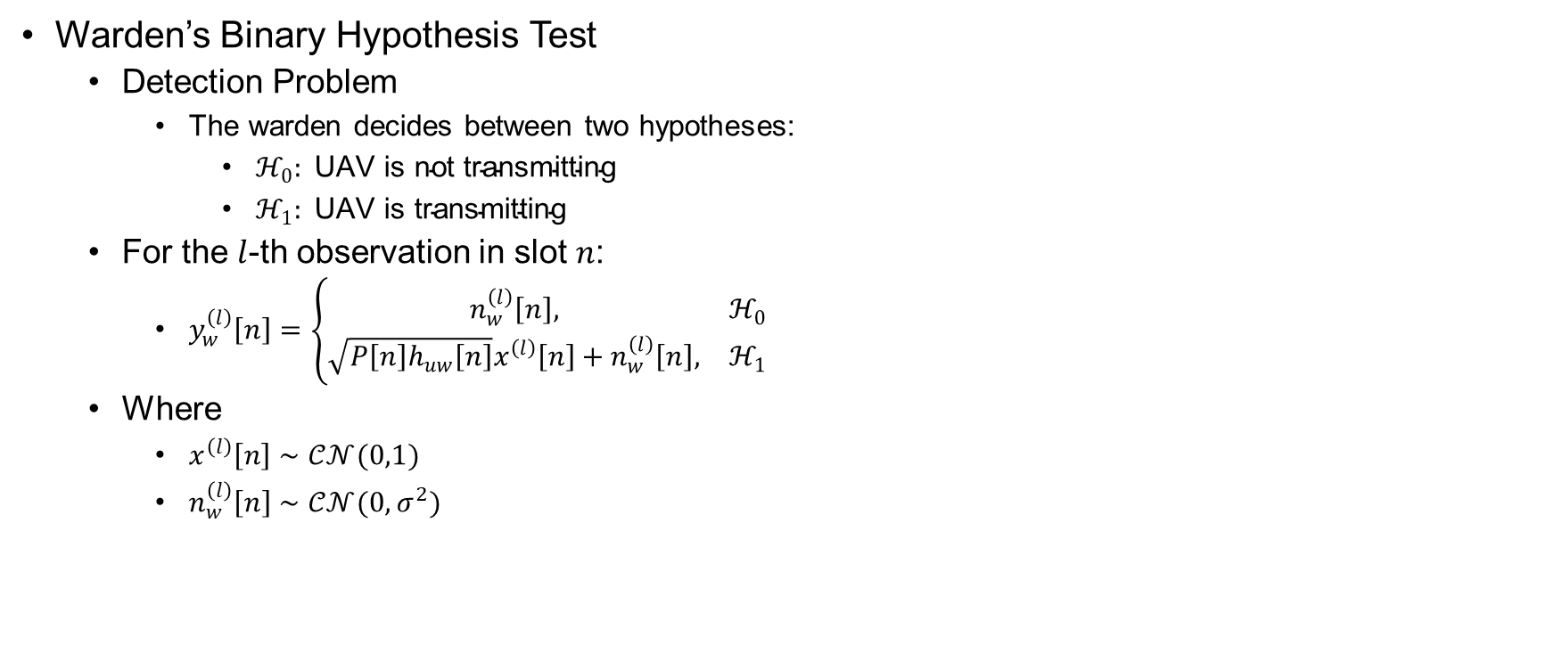
System Model
Warden’s Binary Hypothesis Test
  Detection Problem
    The warden decides between two hypotheses:
      $ℋ_{0}: \text{UAV} \text{is} \text{not} \text{transmitting}$
      $ℋ_{1}: \text{UAV} \text{is} \text{transmitting}$
  For the $l$-th observation in slot $n$:
    $y_{w}^{\left(l\right)}\left[n\right]=\left\{\begin{matrix}n_{w}^{\left(l\right)}\left[n\right], & ℋ_{0} \\ \sqrt{P\left[n\right]h_{uw}\left[n\right]}x^{\left(l\right)}\left[n\right]+n_{w}^{\left(l\right)}\left[n\right], & ℋ_{1}\end{matrix}\right.$
  Where
    $x^{\left(l\right)}\left[n\right]∼𝒞𝒩(0,1)$
    $n_{w}^{\left(l\right)}\left[n\right]∼𝒞𝒩(0,σ^{2})$

Slide 17
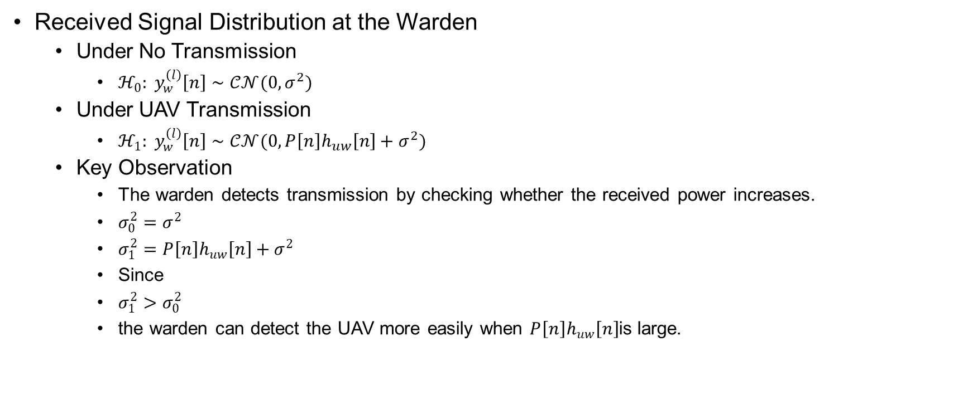
System Model
Received Signal Distribution at the Warden
  Under No Transmission
    $ℋ_{0}: y_{w}^{\left(l\right)}\left[n\right]∼𝒞𝒩(0,σ^{2})$
  Under UAV Transmission
    $ℋ_{1}: y_{w}^{\left(l\right)}\left[n\right]∼𝒞𝒩(0,P\left[n\right]h_{uw}\left[n\right]+σ^{2})$
  Key Observation
    The warden detects transmission by checking whether the received power increases.
    $σ_{0}^{2}=σ^{2}$
    $σ_{1}^{2}=P\left[n\right]h_{uw}\left[n\right]+σ^{2}$
    Since
    $σ_{1}^{2}>σ_{0}^{2}$
    the warden can detect the UAV more easily when $P\left[n\right]h_{uw}\left[n\right]$is large.

Slide 18
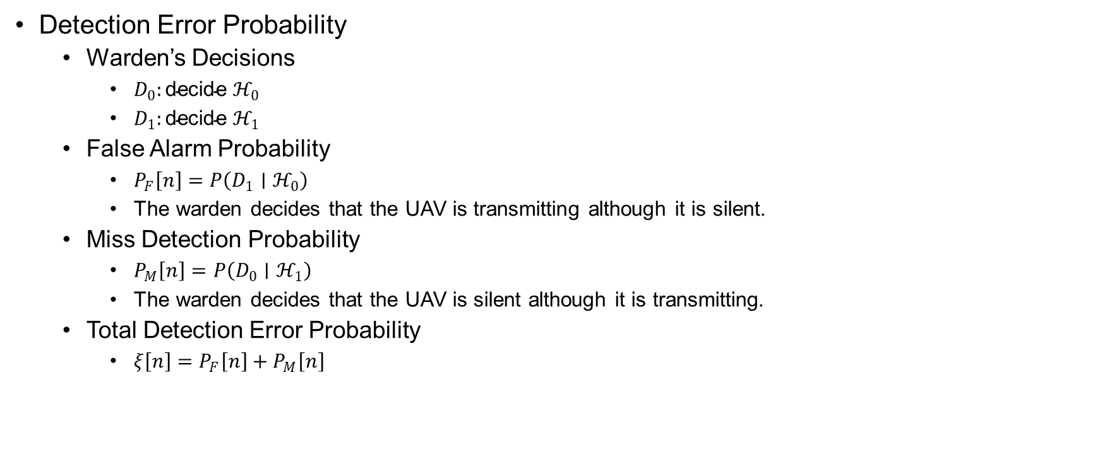
System Model
Detection Error Probability
  Warden’s Decisions
    $D_{0}:\text{decide} ℋ_{0}$
    $D_{1}:\text{decide} ℋ_{1}$
  False Alarm Probability
    $P_{F}\left[n\right]=P\left(D_{1}∣ℋ_{0}\right)$
    The warden decides that the UAV is transmitting although it is silent.
  Miss Detection Probability
    $P_{M}\left[n\right]=P\left(D_{0}∣ℋ_{1}\right)$
    The warden decides that the UAV is silent although it is transmitting.
  Total Detection Error Probability
    $ξ\left[n\right]=P_{F}\left[n\right]+P_{M}\left[n\right]$

Slide 19
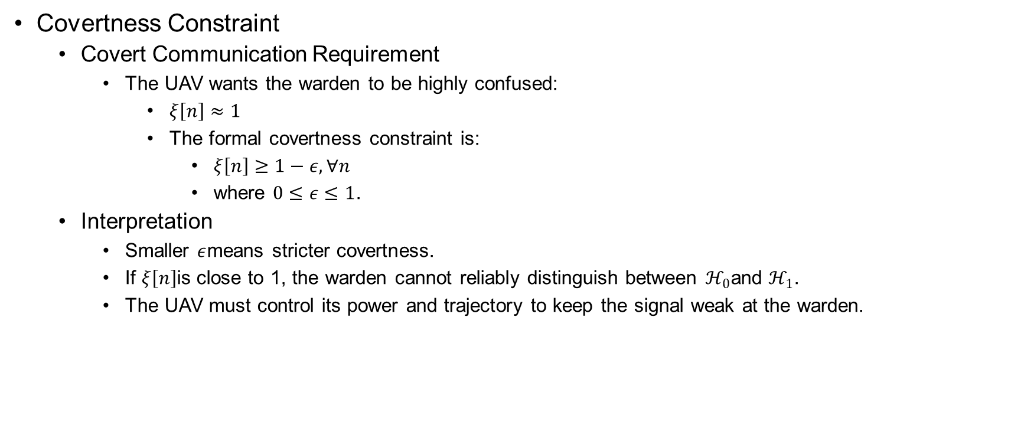
System Model
Covertness Constraint
  Covert Communication Requirement
    The UAV wants the warden to be highly confused:
      $ξ\left[n\right]≈1$
      The formal covertness constraint is:
        $ξ\left[n\right]≥1−ε, ∀n$
        where $0≤ε≤1$.
  Interpretation
    Smaller $ε$means stricter covertness.
    If $ξ\left[n\right]$is close to 1, the warden cannot reliably distinguish between $ℋ_{0}$and $ℋ_{1}$.
    The UAV must control its power and trajectory to keep the signal weak at the warden.

Slide 20
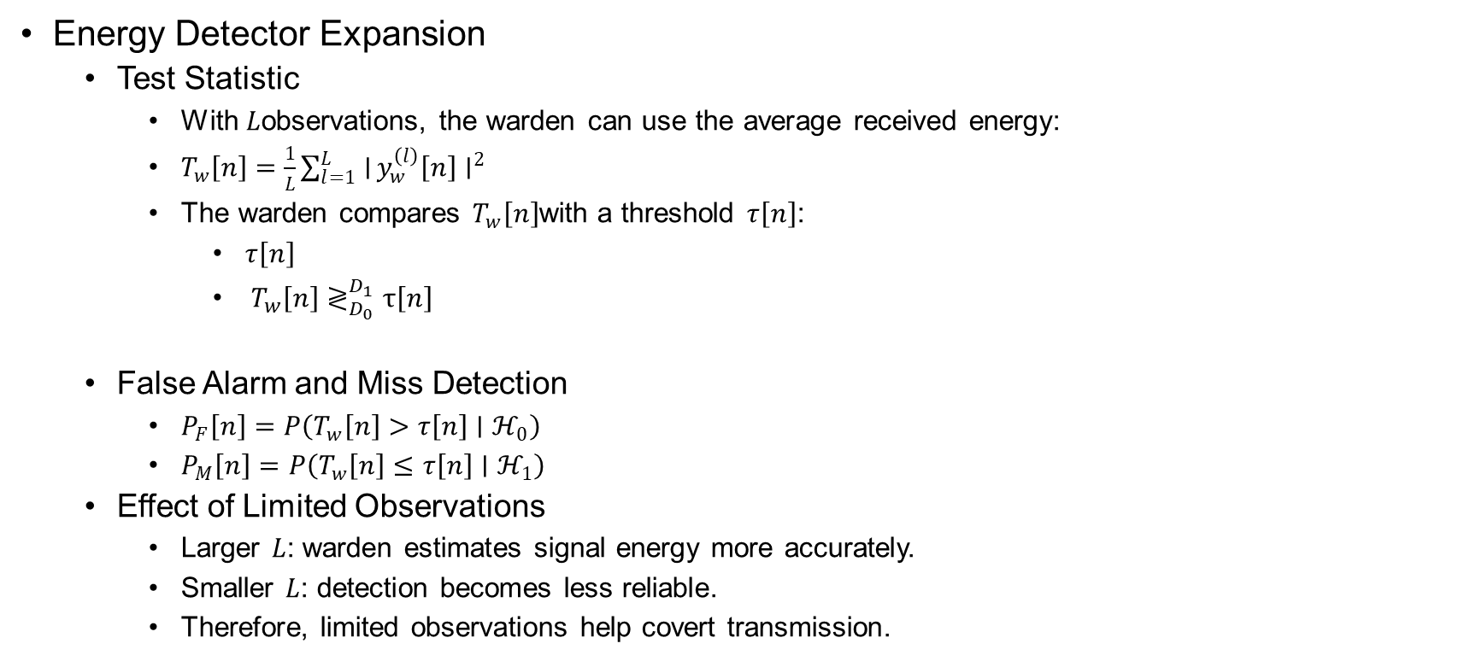
System Model
Energy Detector Expansion
  Test Statistic
    With $L$observations, the warden can use the average received energy:
    $T_{w}\left[n\right]=\frac{1}{L}\sum_{l=1}^{L}{∣}y_{w}^{\left(l\right)}\left[n\right]∣^{2}$
    The warden compares $T_{w}\left[n\right]$with a threshold $τ\left[n\right]$:
      $τ\left[n\right]$
      ${ T}_{w}\left[n\right]≷_{D_{0}}^{D_{1}}τ\left[n\right]$
  False Alarm and Miss Detection
    $P_{F}\left[n\right]=P\left(T_{w}\left[n\right]>τ\left[n\right]∣ℋ_{0}\right)$
    $P_{M}\left[n\right]=P\left(T_{w}\left[n\right]≤τ\left[n\right]∣ℋ_{1}\right)$
  Effect of Limited Observations
    Larger $L$: warden estimates signal energy more accurately.
    Smaller $L$: detection becomes less reliable.
    Therefore, limited observations help covert transmission.

Slide 21
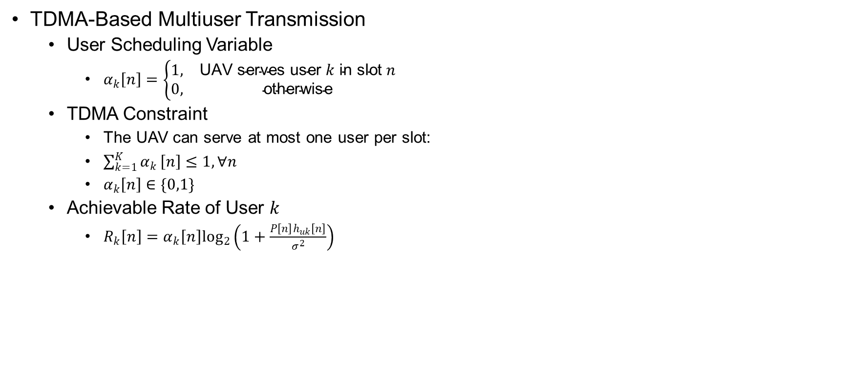
System Model
TDMA-Based Multiuser Transmission
  User Scheduling Variable
    $α_{k}\left[n\right]=\left\{\begin{matrix}1, & \text{UAV} \text{serves} \text{user} k \text{in} \text{slot} n \\ 0, & \text{otherwise}\end{matrix}\right.$
  TDMA Constraint
    The UAV can serve at most one user per slot:
    $\sum_{k=1}^{K}{α_{k}}\left[n\right]≤1, ∀n$
    $α_{k}\left[n\right]∈\{0,1\}$
  Achievable Rate of User $k$
    $R_{k}\left[n\right]=α_{k}\left[n\right]\log_{2}\left(1+\frac{P\left[n\right]h_{uk}\left[n\right]}{σ^{2}}\right)$

Slide 22
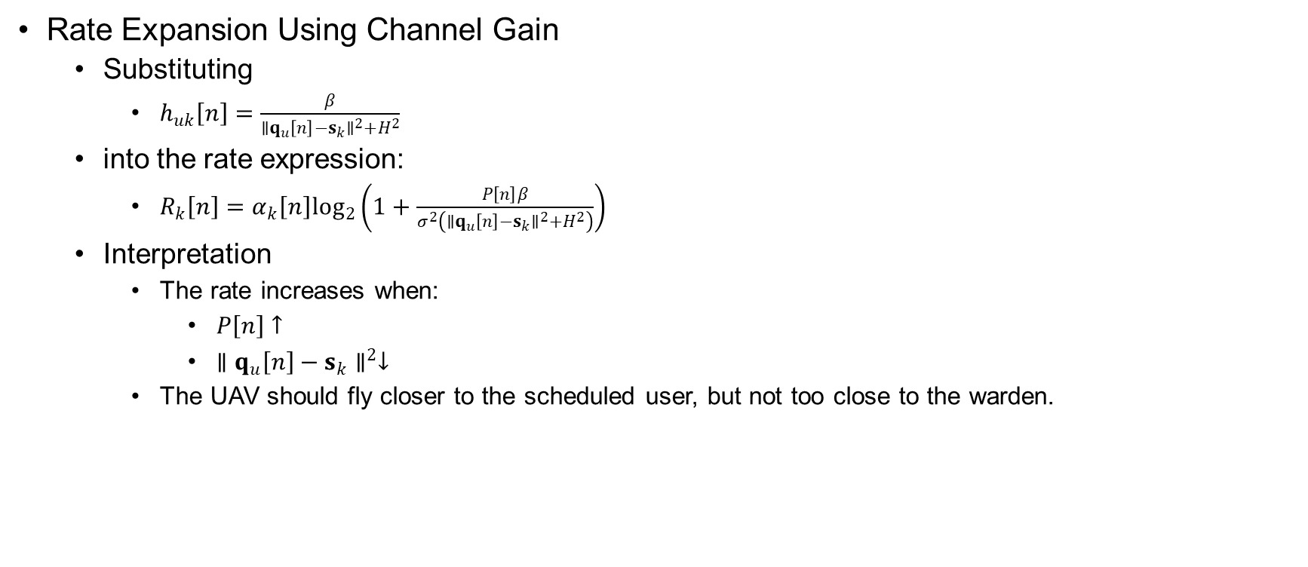
System Model
Rate Expansion Using Channel Gain
  Substituting
    $h_{uk}\left[n\right]=\frac{β}{∥q_{u}\left[n\right]−s_{k}∥^{2}+H^{2}}$
  into the rate expression:
    $R_{k}\left[n\right]=α_{k}\left[n\right]\log_{2}\left(1+\frac{P\left[n\right]β}{σ^{2}\left(∥q_{u}\left[n\right]−s_{k}∥^{2}+H^{2}\right)}\right)$
  Interpretation
    The rate increases when:
      $P\left[n\right]↑$
      $∥q_{u}\left[n\right]−s_{k}∥^{2}↓$
    The UAV should fly closer to the scheduled user, but not too close to the warden.

Slide 23
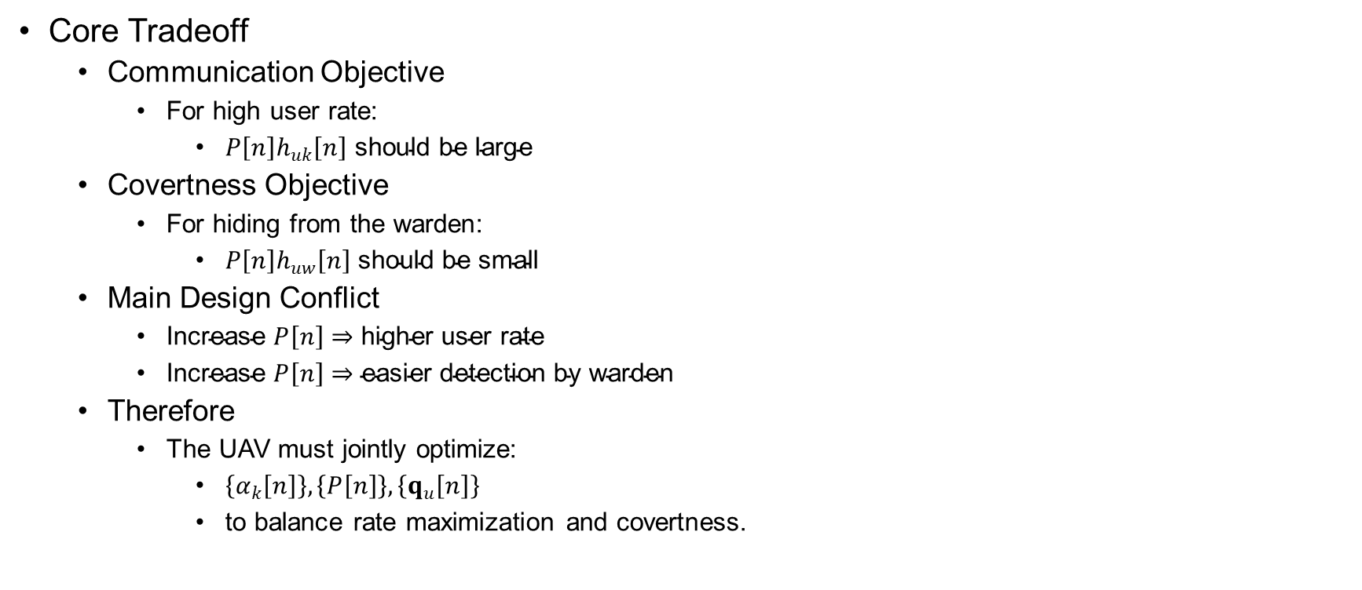
System Model
Core Tradeoff
  Communication Objective
    For high user rate:
      $P\left[n\right]h_{uk}\left[n\right] \text{should} \text{be} \text{large}$
  Covertness Objective
    For hiding from the warden:
      $P\left[n\right]h_{uw}\left[n\right] \text{should} \text{be} \text{small}$
  Main Design Conflict
    $\text{Increase} P\left[n\right]⇒\text{higher} \text{user} \text{rate}$
    $\text{Increase} P\left[n\right]⇒\text{easier} \text{detection} \text{by} \text{warden}$
  Therefore
    The UAV must jointly optimize:
      $\left\{α_{k}\left[n\right]\right\}, \left\{P\left[n\right]\right\}, \left\{q_{u}\left[n\right]\right\}$
      to balance rate maximization and covertness.

Slide 24
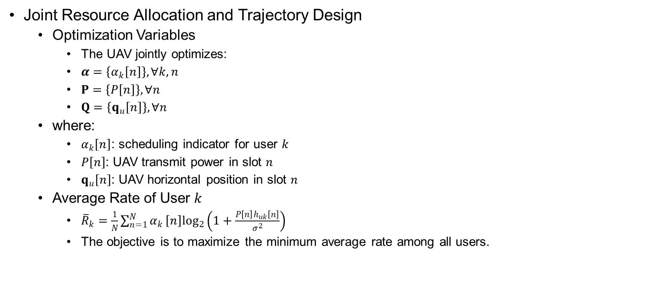
Problem Formulation
Joint Resource Allocation and Trajectory Design
  Optimization Variables
    The UAV jointly optimizes:
    $α=\left\{α_{k}\left[n\right]\right\}, ∀k,n$
    $P=\left\{P\left[n\right]\right\}, ∀n$
    $Q=\left\{q_{u}\left[n\right]\right\}, ∀n$
  where:
    $α_{k}\left[n\right]$: scheduling indicator for user $k$
    $P\left[n\right]$: UAV transmit power in slot $n$
    $q_{u}\left[n\right]$: UAV horizontal position in slot $n$
  Average Rate of User $k$
    ${\overline{R}}_{k}=\frac{1}{N}\sum_{n=1}^{N}{α_{k}}\left[n\right]\log_{2}\left(1+\frac{P\left[n\right]h_{uk}\left[n\right]}{σ^{2}}\right)$
    The objective is to maximize the minimum average rate among all users.

Slide 25
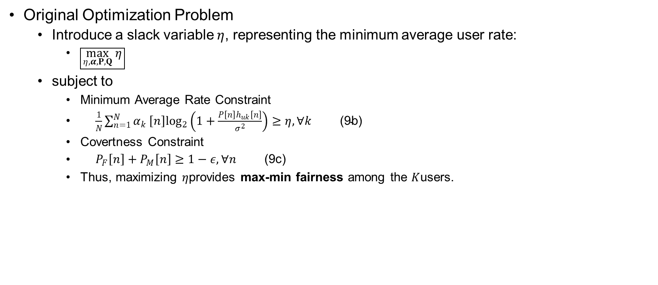
Problem Formulation
Original Optimization Problem
  Introduce a slack variable $η$, representing the minimum average user rate:
    $\boxed{\max_{η,α,P,Q} η}$
  subject to
    Minimum Average Rate Constraint
    $\begin{matrix} & \frac{1}{N}\sum_{n=1}^{N}{α_{k}}\left[n\right]\log_{2}\left(1+\frac{P\left[n\right]h_{uk}\left[n\right]}{σ^{2}}\right)≥η, ∀k & & \text{(9}\text{b}\text{)}\end{matrix}$
    Covertness Constraint
    $\begin{matrix} & P_{F}\left[n\right]+P_{M}\left[n\right]≥1−ε, ∀n & & \text{(9}\text{c}\text{)}\end{matrix}$
    Thus, maximizing $η$provides max-min fairness among the $K$users.

Slide 26
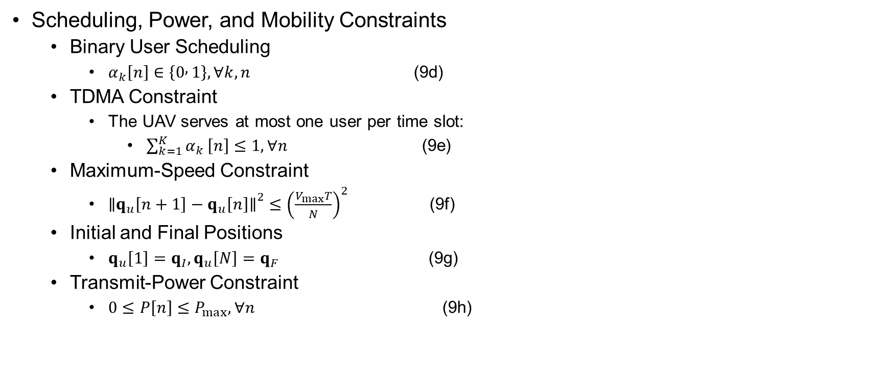
Problem Formulation
Scheduling, Power, and Mobility Constraints
  Binary User Scheduling
    $α_{k}\left[n\right]∈\left\{0 , 1\right\}, ∀k,n$ (9d)
  TDMA Constraint
    The UAV serves at most one user per time slot:
      $\sum_{k=1}^{K}{α_{k}}\left[n\right]≤1, ∀n$ (9e)
  Maximum-Speed Constraint
    ${∥q_{u}\left[n+1\right]−q_{u}\left[n\right]∥}^{2}≤{\left(\frac{V_{max}T}{N}\right)}^{2}$ (9f)
  Initial and Final Positions
    $q_{u}\left[1\right]=q_{I}, q_{u}\left[N\right]=q_{F}$ (9g)
  Transmit-Power Constraint
    $0≤P\left[n\right]≤P_{max}, ∀n$ (9h)

Slide 27
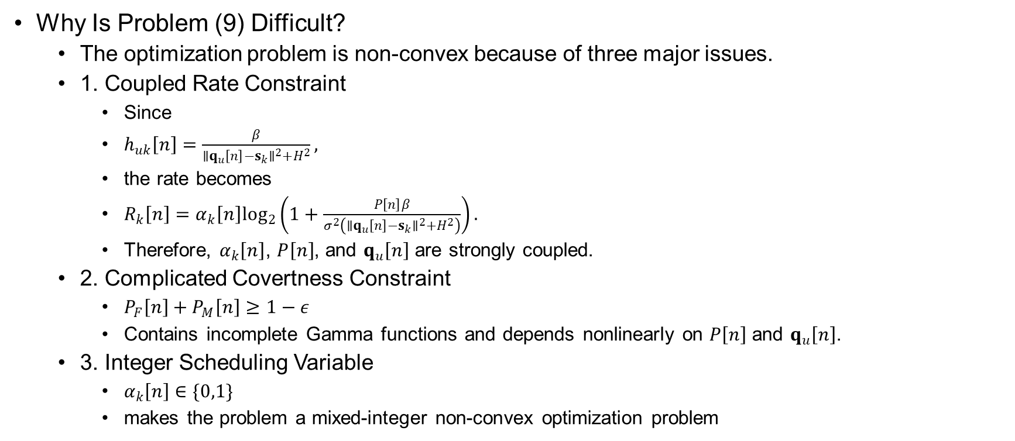
Problem Formulation
Why Is Problem (9) Difficult?
  The optimization problem is non-convex because of three major issues.
  1. Coupled Rate Constraint
    Since
    $h_{uk}\left[n\right]=\frac{β}{∥q_{u}\left[n\right]−s_{k}∥^{2}+H^{2}},$
    the rate becomes
    $R_{k}\left[n\right]=α_{k}\left[n\right]\log_{2}\left(1+\frac{P\left[n\right]β}{σ^{2}\left(∥q_{u}\left[n\right]−s_{k}∥^{2}+H^{2}\right)}\right).$
    Therefore, $α_{k}\left[n\right]$, $P\left[n\right]$, and $q_{u}\left[n\right]$ are strongly coupled.
  2. Complicated Covertness Constraint
    $P_{F}\left[n\right]+P_{M}\left[n\right]≥1−ε$
    Contains incomplete Gamma functions and depends nonlinearly on $P\left[n\right]$ and $q_{u}\left[n\right]$.
  3. Integer Scheduling Variable
    $α_{k}\left[n\right]∈\{0,1\}$
    makes the problem a mixed-integer non-convex optimization problem

Slide 28

Problem Formulation
Warden’s Received-Signal Variances
  Define the collection of $L$observations as
    $Y\left[n\right]={\left\{y_{w}^{\left(l\right)}\left[n\right]\right\}}_{l=1}^{L}.$
  Under the two hypotheses:
    $ℋ_{0}: y_{w}^{\left(l\right)}\left[n\right]∼𝒞𝒩(0,σ^{2})$
    $ℋ_{1}: y_{w}^{\left(l\right)}\left[n\right]∼𝒞𝒩\left(0,{\hat{σ}}^{2}\left[n\right]\right)$
    Where
      ${\hat{σ}}^{2}\left[n\right]=P\left[n\right]h_{uw}\left[n\right]+σ^{2}$
  and
    $h_{uw}\left[n\right]=\frac{β}{∥q_{u}\left[n\right]−w∥^{2}+H^{2}}.$
  Therefore,
    ${\hat{σ}}^{2}\left[n\right]=σ^{2}+\frac{P\left[n\right]β}{∥q_{u}\left[n\right]−w∥^{2}+H^{2}}.$

Slide 29
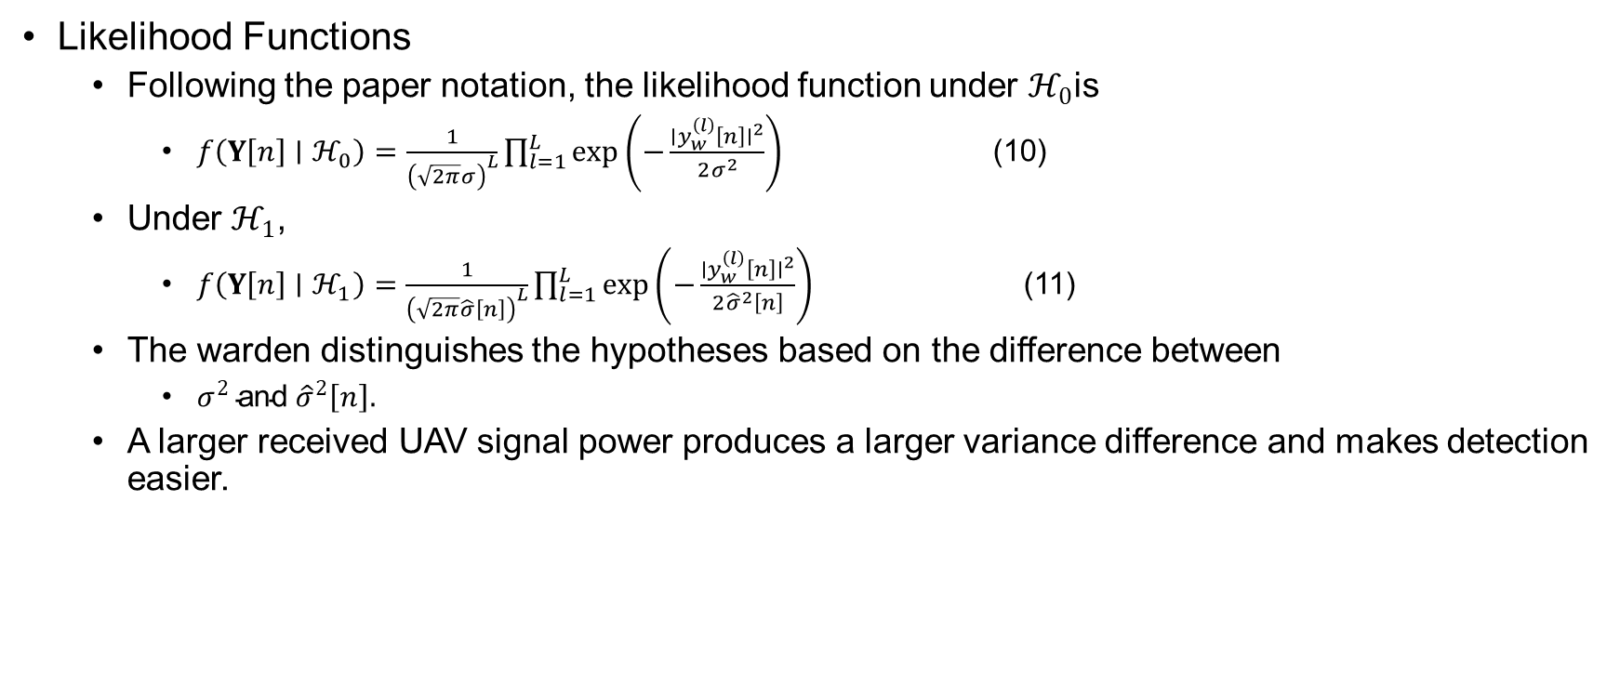
System Model
Likelihood Functions
  Following the paper notation, the likelihood function under $ℋ_{0}$is
    $f\left(Y\left[n\right]∣ℋ_{0}\right)=\frac{1}{{\left(\sqrt{2π}σ\right)}^{L}}\prod_{l=1}^{L}{exp}\left(−\frac{∣y_{w}^{\left(l\right)}\left[n\right]∣^{2}}{2σ^{2}}\right)$ (10)
  Under $ℋ_{1}$,
    $f\left(Y\left[n\right]∣ℋ_{1}\right)=\frac{1}{{\left(\sqrt{2π}\hat{σ}\left[n\right]\right)}^{L}}\prod_{l=1}^{L}{exp}\left(−\frac{∣y_{w}^{\left(l\right)}\left[n\right]∣^{2}}{2{\hat{σ}}^{2}\left[n\right]}\right)$ (11)
  The warden distinguishes the hypotheses based on the difference between
    $σ^{2} \text{and} {\hat{σ}}^{2}\left[n\right].$
  A larger received UAV signal power produces a larger variance difference and makes detection easier.

Slide 30
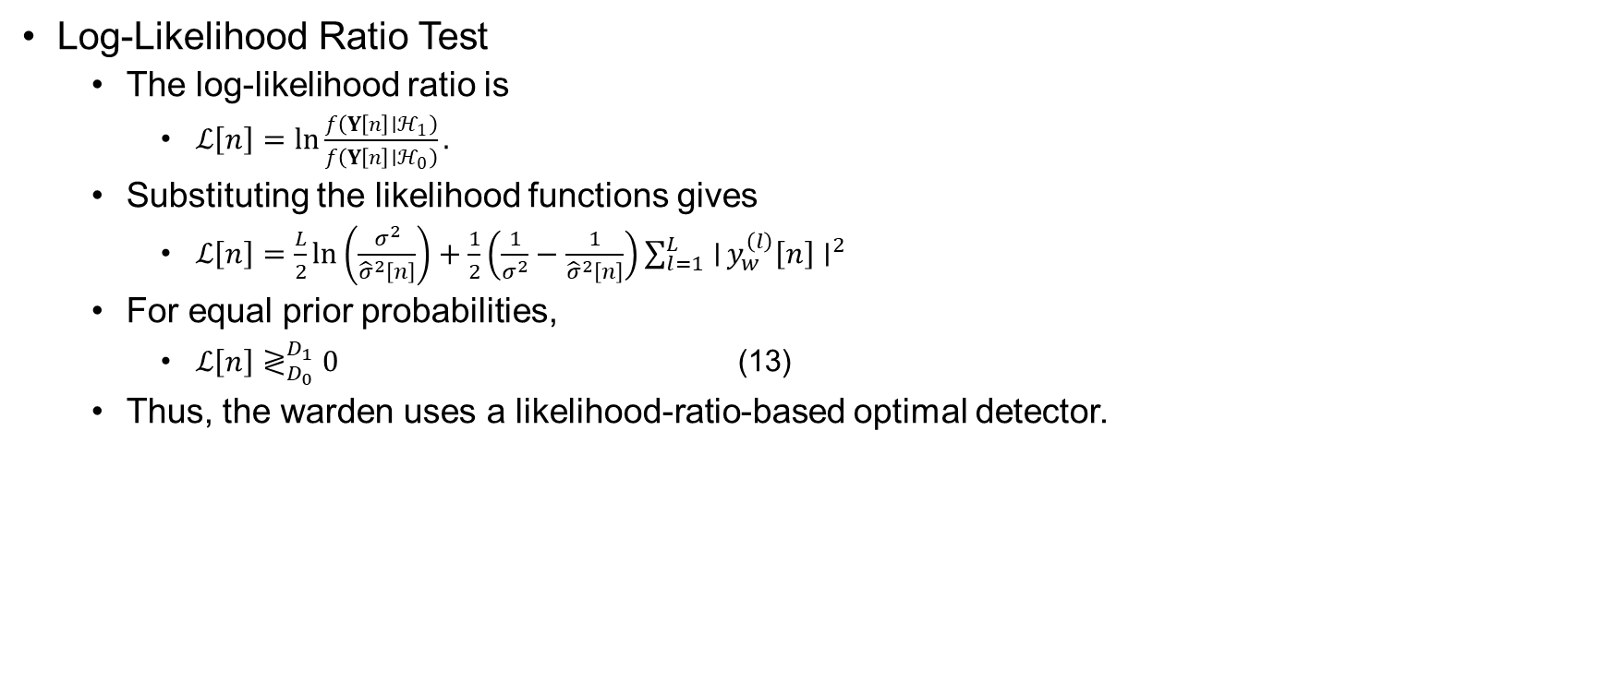
System Model
Log-Likelihood Ratio Test
  The log-likelihood ratio is
    $ℒ\left[n\right]=\ln{\frac{f\left(Y\left[n\right]∣ℋ_{1}\right)}{f\left(Y\left[n\right]∣ℋ_{0}\right)}}.$
  Substituting the likelihood functions gives
    $ℒ\left[n\right]=\frac{L}{2}\ln\left(\frac{σ^{2}}{{\hat{σ}}^{2}\left[n\right]}\right)+\frac{1}{2}\left(\frac{1}{σ^{2}}−\frac{1}{{\hat{σ}}^{2}\left[n\right]}\right)\sum_{l=1}^{L}{∣}y_{w}^{\left(l\right)}\left[n\right]∣^{2}$
  For equal prior probabilities,
    $ℒ\left[n\right]≷_{D_{0}}^{D_{1}}0$ (13)
  Thus, the warden uses a likelihood-ratio-based optimal detector.

Slide 31
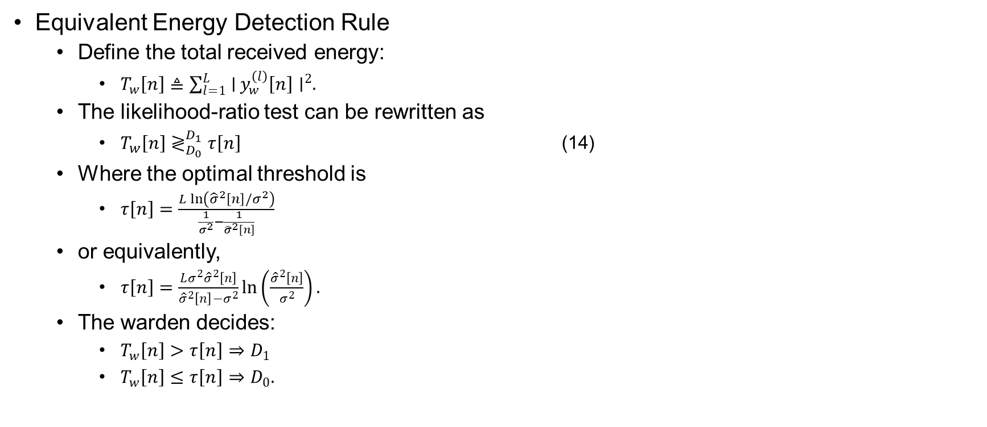
System Model
Equivalent Energy Detection Rule
  Define the total received energy:
    $T_{w}\left[n\right]≜\sum_{l=1}^{L}{∣}y_{w}^{\left(l\right)}\left[n\right]∣^{2}.$
  The likelihood-ratio test can be rewritten as
    $T_{w}\left[n\right]≷_{D_{0}}^{D_{1}}τ\left[n\right]$ (14)
  Where the optimal threshold is
    $τ\left[n\right]=\frac{L\ln\left({\hat{σ}}^{2}\left[n\right]/σ^{2}\right)}{\frac{1}{σ^{2}}−\frac{1}{{\hat{σ}}^{2}\left[n\right]}}$
  or equivalently,
    $τ\left[n\right]=\frac{Lσ^{2}{\hat{σ}}^{2}\left[n\right]}{{\hat{σ}}^{2}\left[n\right]−σ^{2}}\ln\left(\frac{{\hat{σ}}^{2}\left[n\right]}{σ^{2}}\right).$
  The warden decides:
    $T_{w}\left[n\right]>τ\left[n\right]⇒D_{1}$
    $T_{w}\left[n\right]≤τ\left[n\right]⇒D_{0}.$

Slide 32
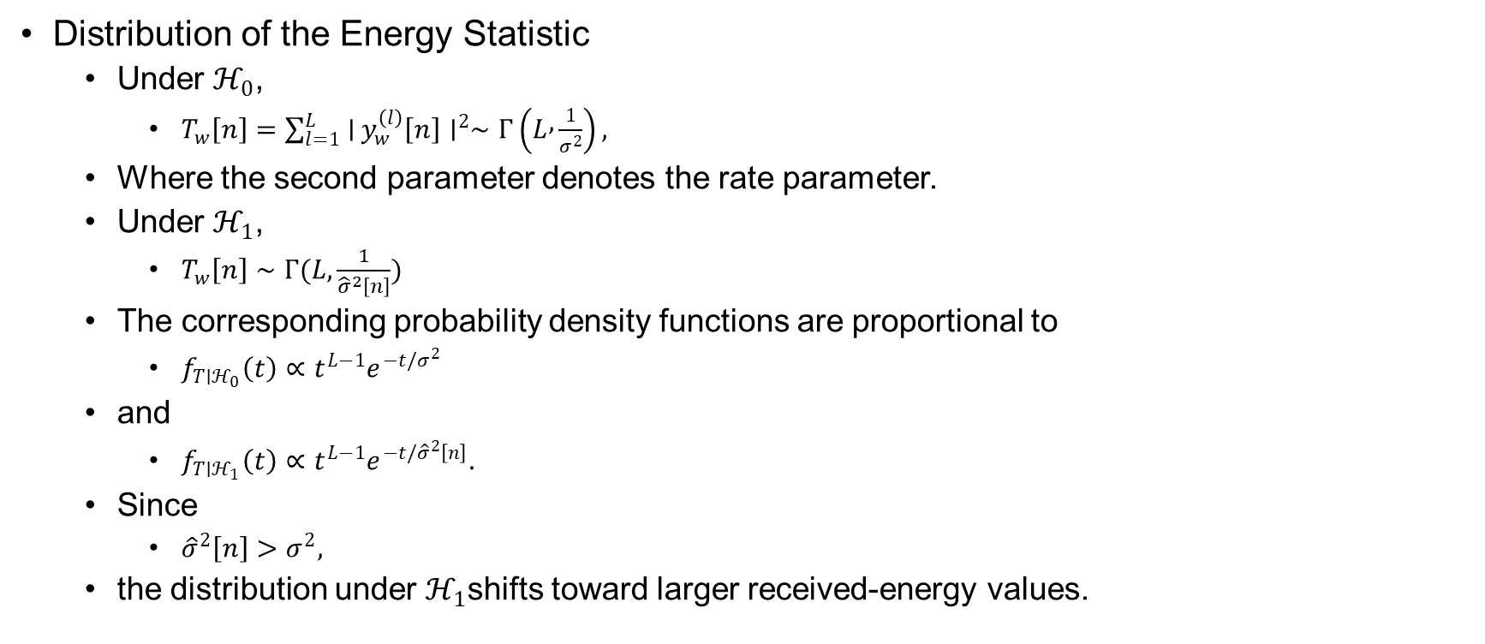
Problem Formulation
Distribution of the Energy Statistic
  Under $ℋ_{0}$,
    $T_{w}\left[n\right]=\sum_{l=1}^{L}{∣}y_{w}^{\left(l\right)}\left[n\right]∣^{2}∼Γ\left(L , \frac{1}{σ^{2}}\right),$
  Where the second parameter denotes the rate parameter.
  Under $ℋ_{1}$,
    $T_{w}\left[n\right]∼Γ(L,\frac{1}{{\hat{σ}}^{2}\left[n\right]})$
  The corresponding probability density functions are proportional to
    $f_{T∣ℋ_{0}}\left(t\right)∝t^{L−1}e^{−t/σ^{2}}$
  and
    $f_{T∣ℋ_{1}}\left(t\right)∝t^{L−1}e^{−t/{\hat{σ}}^{2}\left[n\right]}.$
  Since
    ${\hat{σ}}^{2}\left[n\right]>σ^{2},$
  the distribution under $ℋ_{1}$shifts toward larger received-energy values.

Slide 33

Problem Formulation
False Alarm Probability
  The false alarm event is
    $D_{1}∣ℋ_{0} ⟺ T_{w}\left[n\right]>τ\left[n\right].$
  Therefore,
    $P_{F}\left[n\right]=\operatorname{Pr}\left(T_{w}\left[n\right]>τ\left[n\right]∣ℋ_{0}\right).$
  Using the complementary CDF of the Gamma distribution,
    $P_{F}\left[n\right]=1−\frac{γ\left(L , \frac{τ\left[n\right]}{σ^{2}}\right)}{Γ\left(L\right)}$ (15)
  Since $L$ is an integer,
    $Γ\left(L\right)=\left(L−1\right)!.$
  Thus,
    $P_{F}\left[n\right]=1−\frac{γ\left(L , \frac{τ\left[n\right]}{σ^{2}}\right)}{\left(L−1\right)!}.$

Slide 34

Problem Formulation
Miss Detection Probability
  The miss detection event is
    $D_{0}∣ℋ_{1} ⟺ T_{w}\left[n\right]≤τ\left[n\right].$
  Therefore,
    $P_{M}\left[n\right]=\operatorname{Pr}\left(T_{w}\left[n\right]≤τ\left[n\right]∣ℋ_{1}\right).$
  Using the Gamma CDF,
    $P_{M}\left[n\right]=\frac{γ\left(L,\frac{τ\left[n\right]}{{\hat{σ}}^{2}\left[n\right]}\right)}{Γ\left(L\right)}$ (16)
  or
    $P_{M}\left[n\right]=\frac{γ\left(L,\frac{τ\left[n\right]}{{\hat{σ}}^{2}\left[n\right]}\right)}{\left(L−1\right)!}.$
  The lower incomplete Gamma function is
    $γ(s,x)=\int_{0}^{x}{t^{s−1}}e^{−t} dt.$

Slide 35
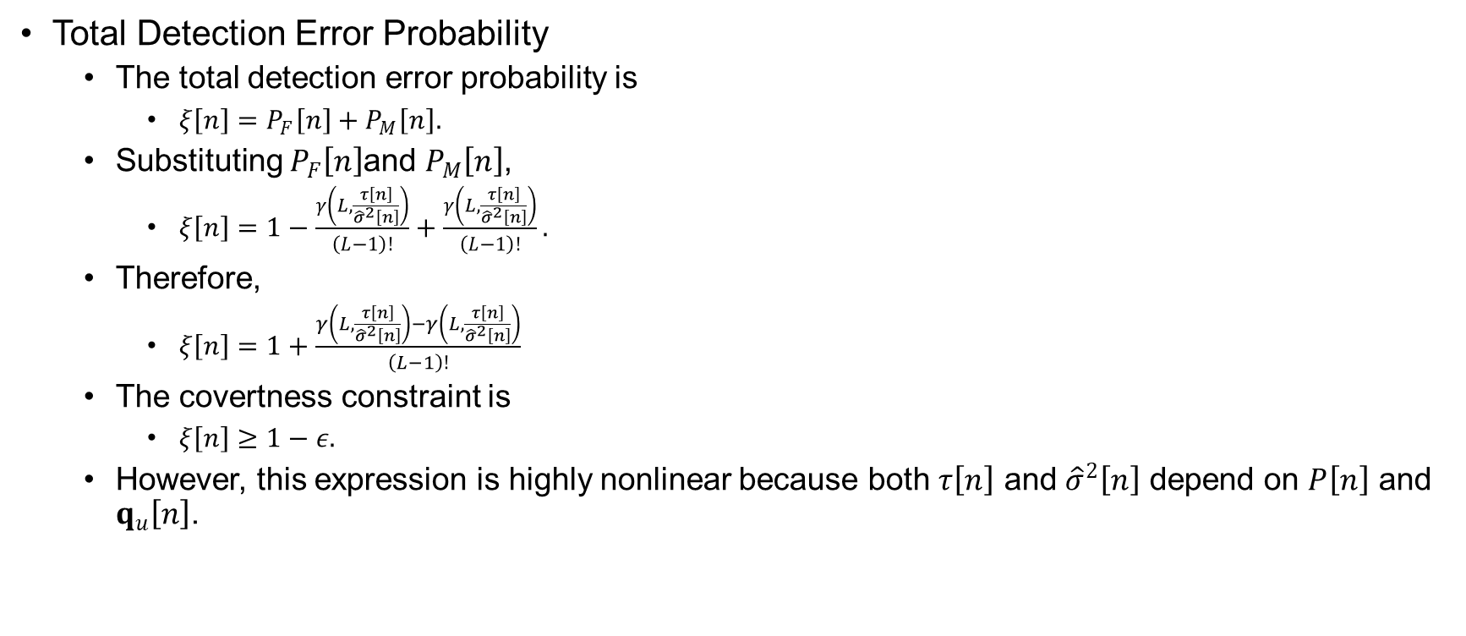
Problem Formulaton
Total Detection Error Probability
  The total detection error probability is
    $ξ\left[n\right]=P_{F}\left[n\right]+P_{M}\left[n\right].$
  Substituting $P_{F}\left[n\right]$and $P_{M}\left[n\right]$,
    $ξ\left[n\right]=1−\frac{γ\left(L,\frac{τ\left[n\right]}{{\hat{σ}}^{2}\left[n\right]}\right)}{\left(L−1\right)!}+\frac{γ\left(L,\frac{τ\left[n\right]}{{\hat{σ}}^{2}\left[n\right]}\right)}{\left(L−1\right)!}.$
  Therefore,
    $ξ\left[n\right]=1+\frac{γ\left(L,\frac{τ\left[n\right]}{{\hat{σ}}^{2}\left[n\right]}\right)−γ\left(L,\frac{τ\left[n\right]}{{\hat{σ}}^{2}\left[n\right]}\right)}{\left(L−1\right)!}$
  The covertness constraint is
    $ξ\left[n\right]≥1−ε.$
  However, this expression is highly nonlinear because both $τ\left[n\right]$ and ${\hat{σ}}^{2}\left[n\right]$ depend on $P\left[n\right]$ and $q_{u}\left[n\right]$.

Slide 36
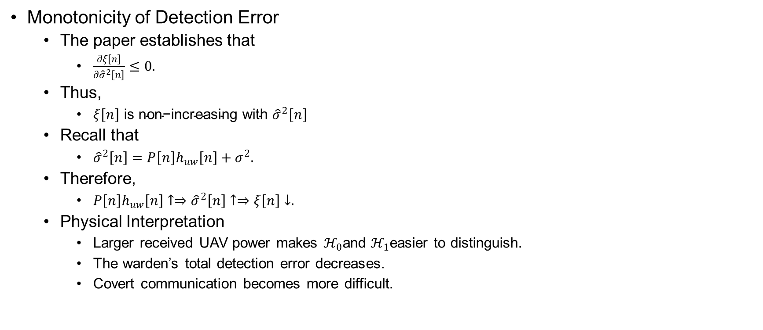
Problem Formulation
Monotonicity of Detection Error
  The paper establishes that
    $\frac{∂ξ\left[n\right]}{∂{\hat{σ}}^{2}\left[n\right]}≤0.$
  Thus,
    $ξ\left[n\right] \text{is} \text{non}\text{−}\text{increasing} \text{with} {\hat{σ}}^{2}\left[n\right]$
  Recall that
    ${\hat{σ}}^{2}\left[n\right]=P\left[n\right]h_{uw}\left[n\right]+σ^{2}.$
  Therefore,
    $P\left[n\right]h_{uw}\left[n\right]↑⇒{\hat{σ}}^{2}\left[n\right]↑⇒ξ\left[n\right]↓.$
  Physical Interpretation
    Larger received UAV power makes $ℋ_{0}$and $ℋ_{1}$easier to distinguish.
    The warden’s total detection error decreases.
    Covert communication becomes more difficult.

Slide 37
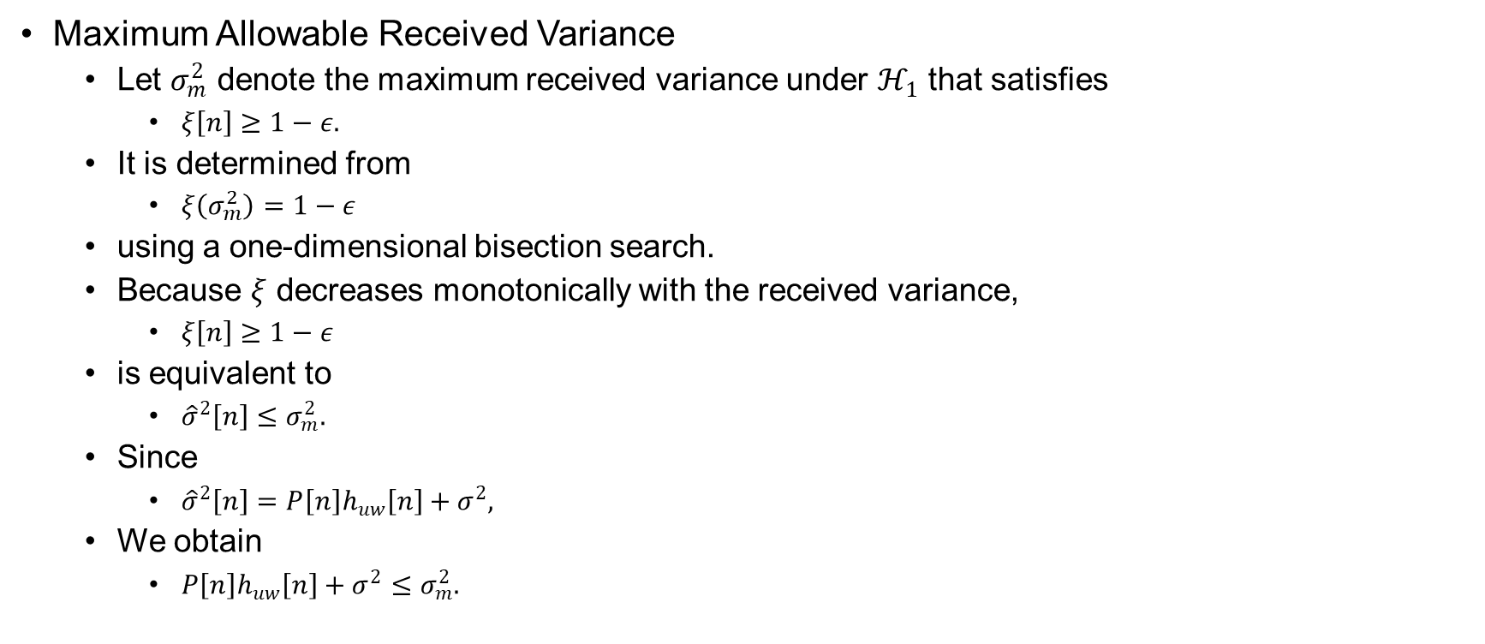
Problem Formulation
Maximum Allowable Received Variance
  Let $σ_{m}^{2}$ denote the maximum received variance under $ℋ_{1}$ that satisfies
    $ξ\left[n\right]≥1−ε.$
  It is determined from
    $ξ\left(σ_{m}^{2}\right)=1−ε$
  using a one-dimensional bisection search.
  Because $ξ$ decreases monotonically with the received variance,
    $ξ\left[n\right]≥1−ε$
  is equivalent to
    ${\hat{σ}}^{2}\left[n\right]≤σ_{m}^{2}.$
  Since
    ${\hat{σ}}^{2}\left[n\right]=P\left[n\right]h_{uw}\left[n\right]+σ^{2},$
  We obtain
    $P\left[n\right]h_{uw}\left[n\right]+σ^{2}≤σ_{m}^{2}.$

Slide 38
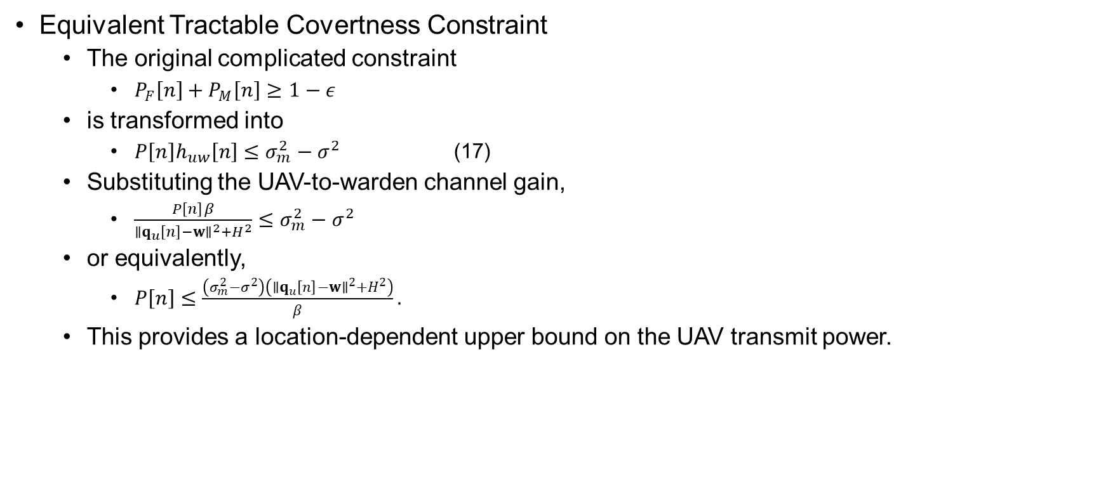
Problem Formulation
Equivalent Tractable Covertness Constraint
  The original complicated constraint
    $P_{F}\left[n\right]+P_{M}\left[n\right]≥1−ε$
  is transformed into
    $P\left[n\right]h_{uw}\left[n\right]≤σ_{m}^{2}−σ^{2}$ (17)
  Substituting the UAV-to-warden channel gain,
    $\frac{P\left[n\right]β}{∥q_{u}\left[n\right]−w∥^{2}+H^{2}}≤σ_{m}^{2}−σ^{2}$
  or equivalently,
    $P\left[n\right]≤\frac{\left(σ_{m}^{2}−σ^{2}\right)\left(∥q_{u}\left[n\right]−w∥^{2}+H^{2}\right)}{β}.$
  This provides a location-dependent upper bound on the UAV transmit power.

Slide 39
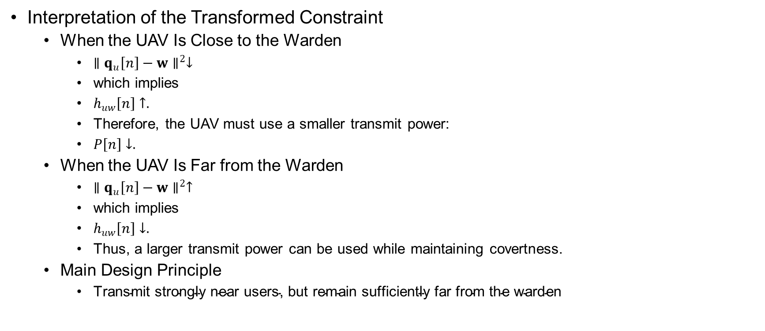
Problem Formulation
Interpretation of the Transformed Constraint
  When the UAV Is Close to the Warden
    $∥q_{u}\left[n\right]−w∥^{2}↓$
    which implies
    $h_{uw}\left[n\right]↑.$
    Therefore, the UAV must use a smaller transmit power:
    $P\left[n\right]↓.$
  When the UAV Is Far from the Warden
    $∥q_{u}\left[n\right]−w∥^{2}↑$
    which implies
    $h_{uw}\left[n\right]↓.$
    Thus, a larger transmit power can be used while maintaining covertness.
  Main Design Principle
    $\text{Transmit} \text{strongly} \text{near} \text{users}\text{, }\text{but} \text{remain} \text{sufficiently} \text{far} \text{from} \text{the} \text{warden}$

Slide 40
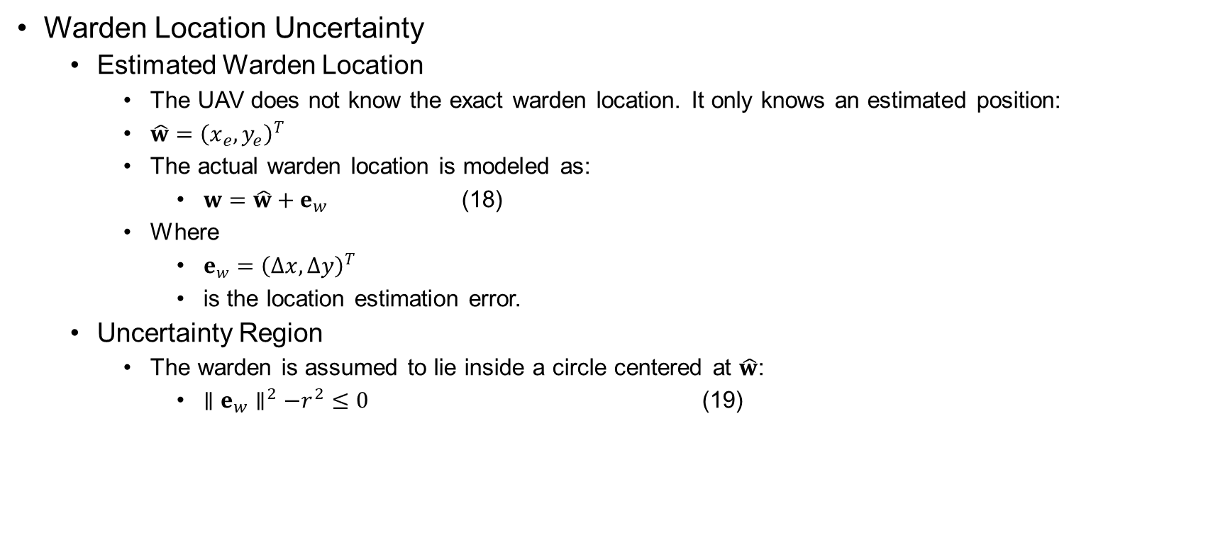
Problem Formulation
Warden Location Uncertainty
  Estimated Warden Location
    The UAV does not know the exact warden location. It only knows an estimated position:
    $\hat{w}={\left(x_{e},y_{e}\right)}^{T}$
    The actual warden location is modeled as:
      $w=\hat{w}+e_{w}$ (18)
    Where
      $e_{w}={\left(∆x,∆y\right)}^{T}$
      is the location estimation error.
  Uncertainty Region
    The warden is assumed to lie inside a circle centered at $\hat{w}$:
      $∥e_{w}∥^{2}−r^{2}≤0$ (19)

Slide 41
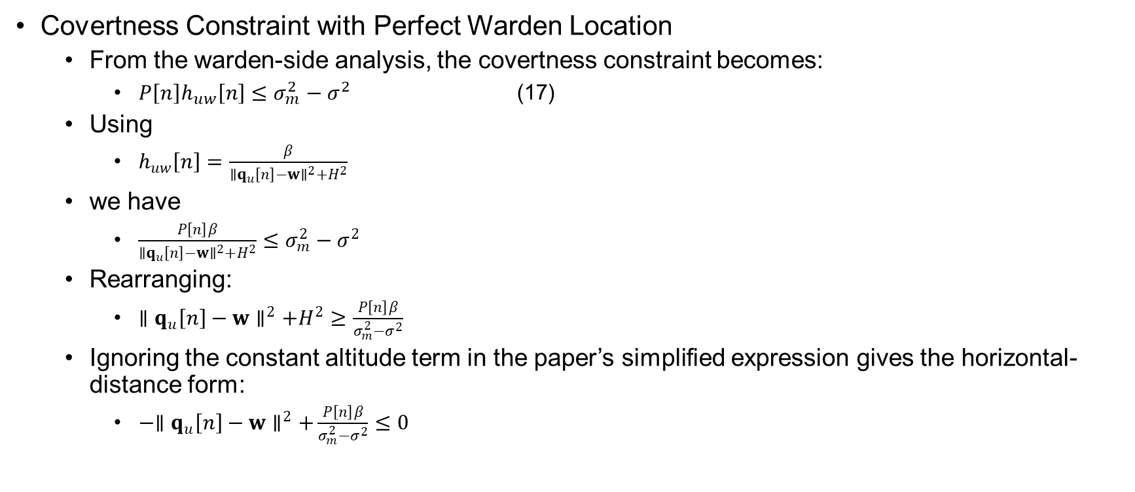
Problem Formulation
Covertness Constraint with Perfect Warden Location
  From the warden-side analysis, the covertness constraint becomes:
    $P\left[n\right]h_{uw}\left[n\right]≤σ_{m}^{2}−σ^{2}$ (17)
  Using
    $h_{uw}\left[n\right]=\frac{β}{∥q_{u}\left[n\right]−w∥^{2}+H^{2}}$
  we have
    $\frac{P\left[n\right]β}{∥q_{u}\left[n\right]−w∥^{2}+H^{2}}≤σ_{m}^{2}−σ^{2}$
  Rearranging:
    $∥q_{u}\left[n\right]−w∥^{2}+H^{2}≥\frac{P\left[n\right]β}{σ_{m}^{2}−σ^{2}}$
  Ignoring the constant altitude term in the paper’s simplified expression gives the horizontal-distance form:
    $−∥q_{u}\left[n\right]−w∥^{2}+\frac{P\left[n\right]β}{σ_{m}^{2}−σ^{2}}≤0$

Slide 42
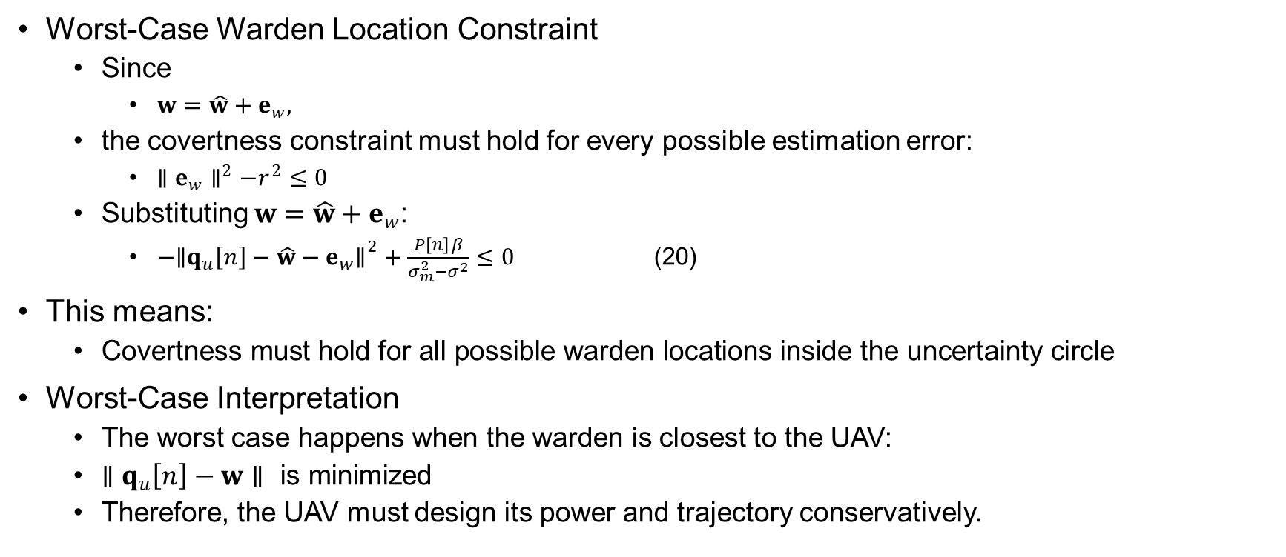
Problem Formulation
Worst-Case Warden Location Constraint
  Since
    $w=\hat{w}+e_{w},$
  the covertness constraint must hold for every possible estimation error:
    $∥e_{w}∥^{2}−r^{2}≤0$
  Substituting $w=\hat{w}+e_{w}$:
    $−{∥q_{u}\left[n\right]−\hat{w}−e_{w}∥}^{2}+\frac{P\left[n\right]β}{σ_{m}^{2}−σ^{2}}≤0$ (20)
This means:
  $\text{Covertness} \text{must} \text{hold} \text{for} \text{all} \text{possible} \text{warden} \text{locations} \text{inside} \text{the} \text{uncertainty} \text{circle}$
Worst-Case Interpretation
  The worst case happens when the warden is closest to the UAV:
  $∥q_{u}\left[n\right]−w∥ \text{is} \text{minimized}$
  Therefore, the UAV must design its power and trajectory conservatively.

Slide 43
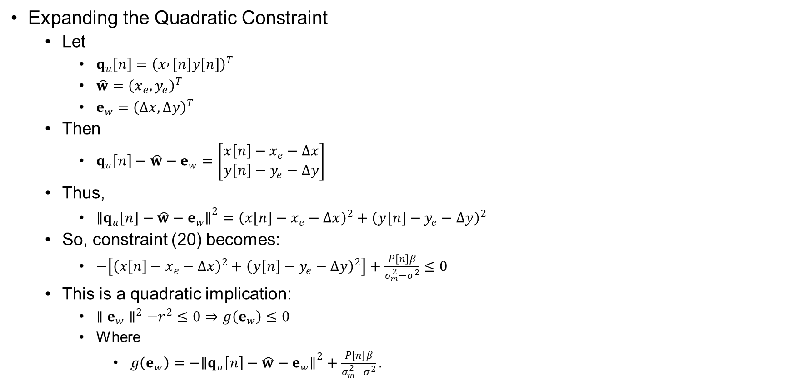
Problem Formulation
Expanding the Quadratic Constraint
  Let
    $q_{u}\left[n\right]={\left(x , \left[n\right]y\left[n\right]\right)}^{T}$
    $\hat{w}={\left(x_{e},y_{e}\right)}^{T}$
    $e_{w}={\left(∆x,∆y\right)}^{T}$
  Then
    $q_{u}\left[n\right]−\hat{w}−e_{w}=\left[\begin{matrix}x\left[n\right]−x_{e}−Δx \\ y\left[n\right]−y_{e}−Δy\end{matrix}\right]$
  Thus,
    ${∥q_{u}\left[n\right]−\hat{w}−e_{w}∥}^{2}={\left(x\left[n\right]−x_{e}−Δx\right)}^{2}+{\left(y\left[n\right]−y_{e}−Δy\right)}^{2}$
  So, constraint (20) becomes:
    $−\left[{\left(x\left[n\right]−x_{e}−Δx\right)}^{2}+{\left(y\left[n\right]−y_{e}−Δy\right)}^{2}\right]+\frac{P\left[n\right]β}{σ_{m}^{2}−σ^{2}}≤0$
  This is a quadratic implication:
    $∥e_{w}∥^{2}−r^{2}≤0⇒g\left(e_{w}\right)≤0$
    Where
      $g\left(e_{w}\right)=−{∥q_{u}\left[n\right]−\hat{w}−e_{w}∥}^{2}+\frac{P\left[n\right]β}{σ_{m}^{2}−σ^{2}}.$

Slide 44
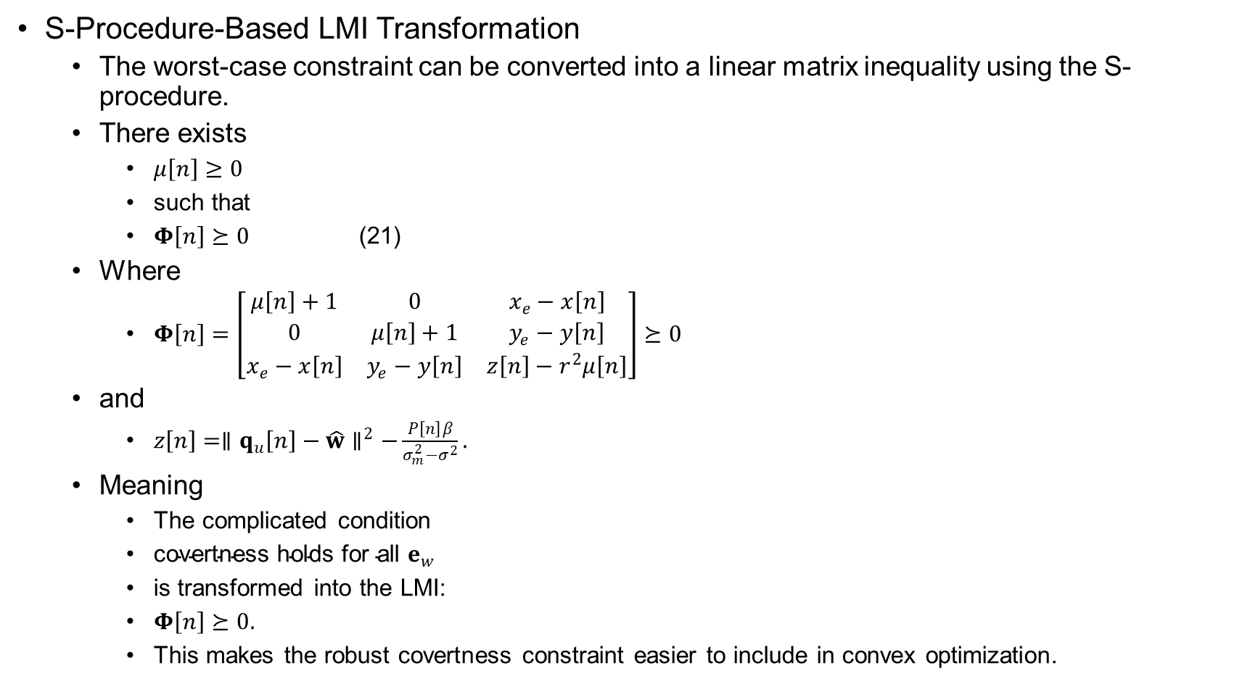
Problem Formulation
S-Procedure-Based LMI Transformation
  The worst-case constraint can be converted into a linear matrix inequality using the S-procedure.
  There exists
    $μ\left[n\right]≥0$
    such that
    $Φ\left[n\right]⪰0$ (21)
  Where
    $Φ\left[n\right]=\left[\begin{matrix}μ\left[n\right]+1 & 0 & x_{e}−x\left[n\right] \\ 0 & μ\left[n\right]+1 & y_{e}−y\left[n\right] \\ x_{e}−x\left[n\right] & y_{e}−y\left[n\right] & z\left[n\right]−r^{2}μ\left[n\right]\end{matrix}\right]⪰0$
  and
    $z\left[n\right]=∥q_{u}\left[n\right]−\hat{w}∥^{2}−\frac{P\left[n\right]β}{σ_{m}^{2}−σ^{2}}.$
  Meaning
    The complicated condition
    $\text{covertness} \text{holds} \text{for} \text{all} e_{w}$
    is transformed into the LMI:
    $Φ\left[n\right]⪰0.$
    This makes the robust covertness constraint easier to include in convex optimization.

Slide 45
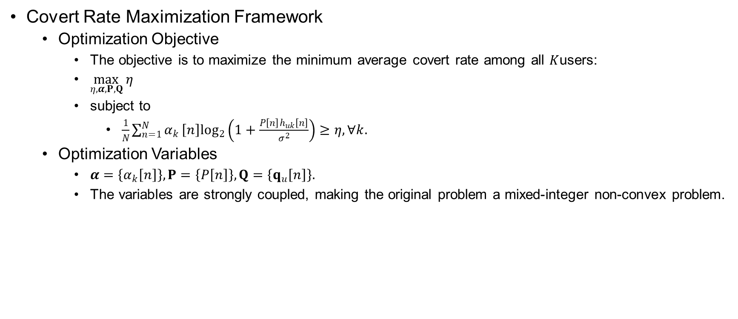
Covert Rate Maximization
Covert Rate Maximization Framework
  Optimization Objective
    The objective is to maximize the minimum average covert rate among all $K$users:
    $\max_{η,α,P,Q} η$
    subject to
      $\frac{1}{N}\sum_{n=1}^{N}{α_{k}}\left[n\right]\log_{2}\left(1+\frac{P\left[n\right]h_{uk}\left[n\right]}{σ^{2}}\right)≥η, ∀k.$
  Optimization Variables
    $α=\left\{α_{k}\left[n\right]\right\}, P=\left\{P\left[n\right]\right\}, Q=\left\{q_{u}\left[n\right]\right\}.$
    The variables are strongly coupled, making the original problem a mixed-integer non-convex problem.

Slide 46
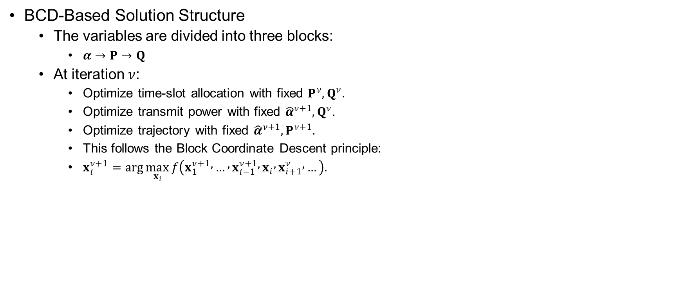
Covert Rate Maximization
BCD-Based Solution Structure
  The variables are divided into three blocks:
    $α→P→Q$
  At iteration $ν$:
    Optimize time-slot allocation with fixed $P^{ν},Q^{ν}$.
    Optimize transmit power with fixed ${\hat{α}}^{ν+1},Q^{ν}$.
    Optimize trajectory with fixed ${\hat{α}}^{ν+1},P^{ν+1}$.
    This follows the Block Coordinate Descent principle:
    $x_{i}^{ν+1}=\arg{\max_{x_{i}}}f\left(x_{1}^{ν+1} , … , x_{i−1}^{ν+1} , x_{i} , x_{i+1}^{ν} , …\right).$

Slide 47
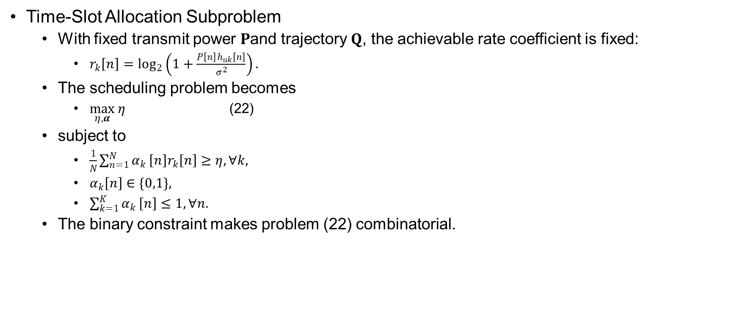
Covert Rate Maximization
Time-Slot Allocation Subproblem
  With fixed transmit power $P$and trajectory $Q$, the achievable rate coefficient is fixed:
    $r_{k}\left[n\right]=\log_{2}\left(1+\frac{P\left[n\right]h_{uk}\left[n\right]}{σ^{2}}\right).$
  The scheduling problem becomes
    $\max_{η,α} η$ (22)
  subject to
    $\frac{1}{N}\sum_{n=1}^{N}{α_{k}}\left[n\right]r_{k}\left[n\right]≥η, ∀k,$
    $α_{k}\left[n\right]∈\{0,1\},$
    $\sum_{k=1}^{K}{α_{k}}\left[n\right]≤1, ∀n.$
  The binary constraint makes problem (22) combinatorial.

Slide 48
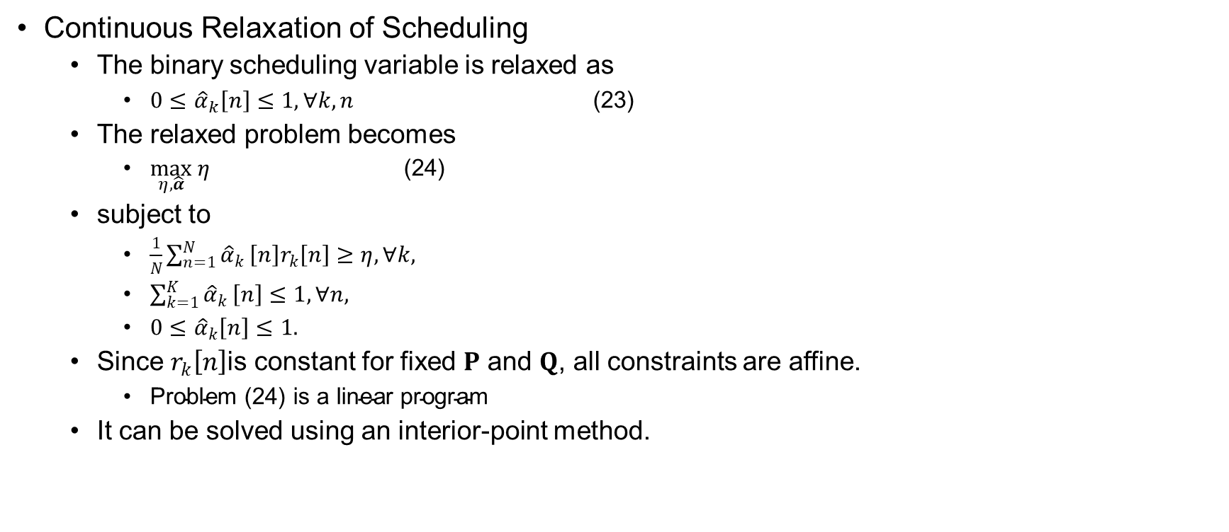
Covert Rate Maximization
Continuous Relaxation of Scheduling
  The binary scheduling variable is relaxed as
    $0≤{\hat{α}}_{k}\left[n\right]≤1, ∀k,n$ (23)
  The relaxed problem becomes
    $\max_{η,\hat{α}} η$ (24)
  subject to
    $\frac{1}{N}\sum_{n=1}^{N}{{\hat{α}}_{k}}\left[n\right]r_{k}\left[n\right]≥η, ∀k,$
    $\sum_{k=1}^{K}{{\hat{α}}_{k}}\left[n\right]≤1, ∀n,$
    $0≤{\hat{α}}_{k}\left[n\right]≤1.$
  Since $r_{k}\left[n\right]$is constant for fixed $P$ and $Q$, all constraints are affine.
    $\text{Problem}\text{ (24) }\text{is} \text{a} \text{linear} \text{program}$
  It can be solved using an interior-point method.

Slide 49
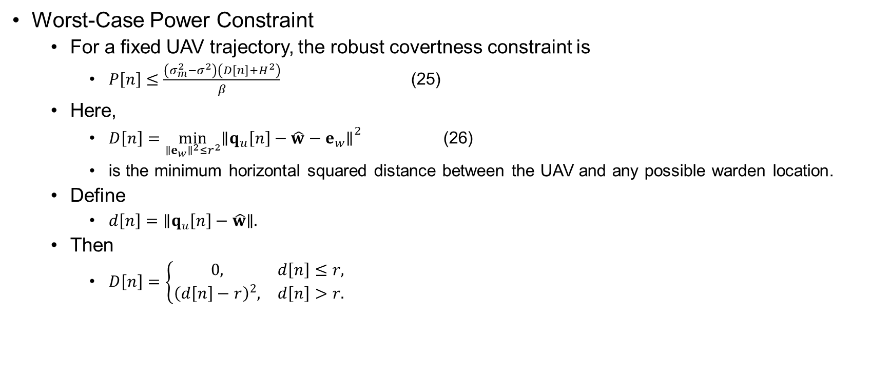
Covert Rate Maximization
Worst-Case Power Constraint
  For a fixed UAV trajectory, the robust covertness constraint is
    $P\left[n\right]≤\frac{\left(σ_{m}^{2}−σ^{2}\right)\left(D\left[n\right]+H^{2}\right)}{β}$ (25)
  Here,
    $D\left[n\right]=\min_{∥e_{w}∥^{2}≤r^{2}}{∥q_{u}\left[n\right]−\hat{w}−e_{w}∥}^{2}$ (26)
    is the minimum horizontal squared distance between the UAV and any possible warden location.
  Define
    $d\left[n\right]=∥q_{u}\left[n\right]−\hat{w}∥.$
  Then
    $D\left[n\right]=\left\{\begin{matrix}0, & d\left[n\right]≤r, \\ {\left(d\left[n\right]−r\right)}^{2}, & d\left[n\right]>r.\end{matrix}\right.$

Slide 50
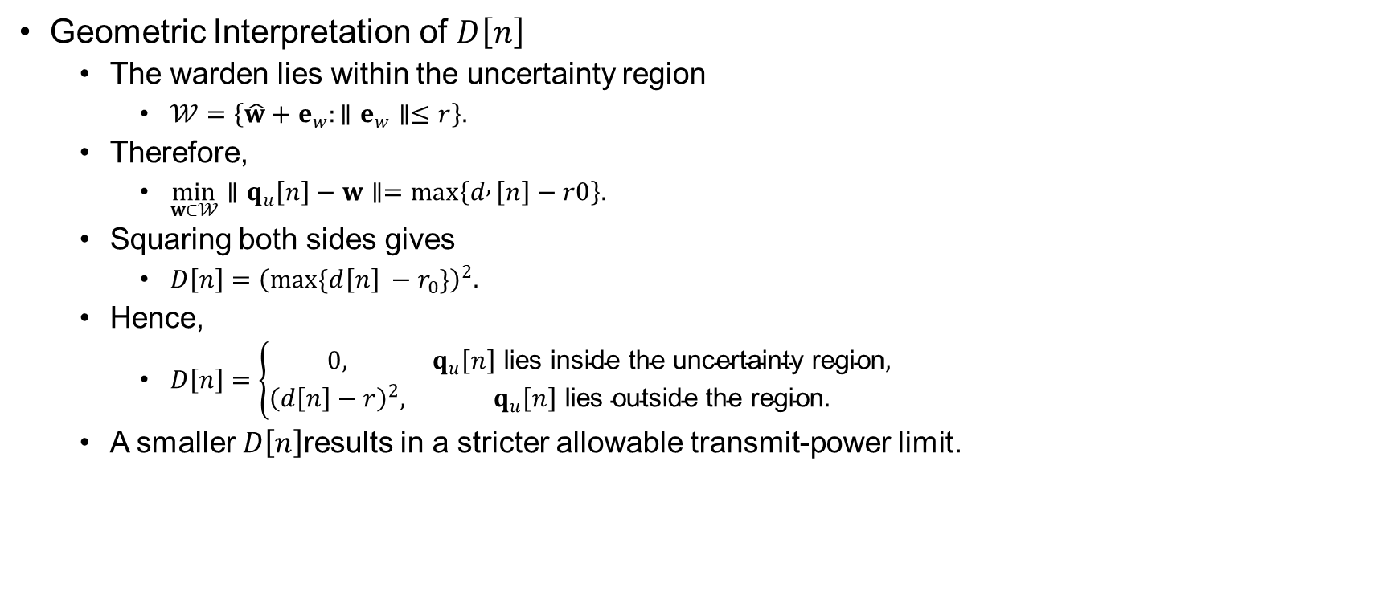
Covert Rate Maximization
Geometric Interpretation of $D\left[n\right]$
  The warden lies within the uncertainty region
    $𝒲=\left\{\hat{w}+e_{w}:∥e_{w}∥≤r\right\}.$
  Therefore,
    $\min_{w∈𝒲}∥q_{u}\left[n\right]−w∥=max⁡\left\{d , \left[n\right]−r0\right\}.$
  Squaring both sides gives
    $D\left[n\right]={\left(max⁡\{d\left[n\right] −r_{0}\}\right)}^{2}.$
  Hence,
    $D\left[n\right]=\left\{\begin{matrix}0, & q_{u}\left[n\right] \text{lies} \text{inside} \text{the} \text{uncertainty} \text{region}, \\ {\left(d\left[n\right]−r\right)}^{2}, & q_{u}\left[n\right] \text{lies} \text{outside} \text{the} \text{region}.\end{matrix}\right.$
  A smaller $D\left[n\right]$results in a stricter allowable transmit-power limit.

Slide 51
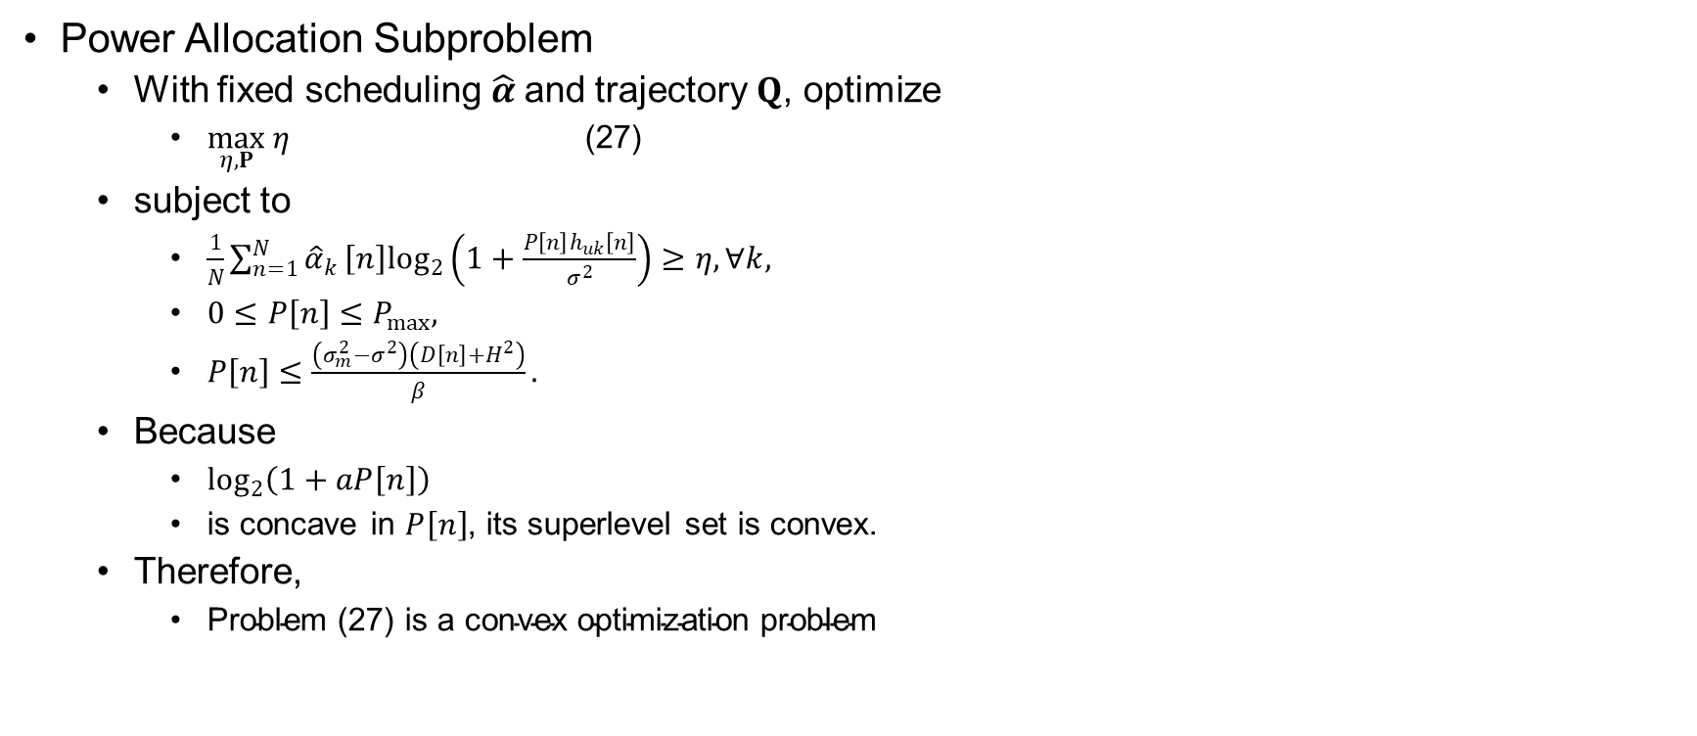
Covert Rate Maximization
Power Allocation Subproblem
  With fixed scheduling $\hat{α}$and trajectory $Q$, optimize
    $\max_{η,P} η$ (27)
  subject to
    $\frac{1}{N}\sum_{n=1}^{N}{{\hat{α}}_{k}}\left[n\right]\log_{2}\left(1+\frac{P\left[n\right]h_{uk}\left[n\right]}{σ^{2}}\right)≥η, ∀k,$
    $0≤P\left[n\right]≤P_{max},$
    $P\left[n\right]≤\frac{\left(σ_{m}^{2}−σ^{2}\right)\left(D\left[n\right]+H^{2}\right)}{β}.$
  Because
    $\log_{2}\left(1+aP\left[n\right]\right)$
    is concave in $P\left[n\right]$, its superlevel set is convex.
  Therefore,
    $\text{Problem}\text{ (27) }\text{is} \text{a} \text{convex} \text{optimization} \text{problem}$

Slide 52
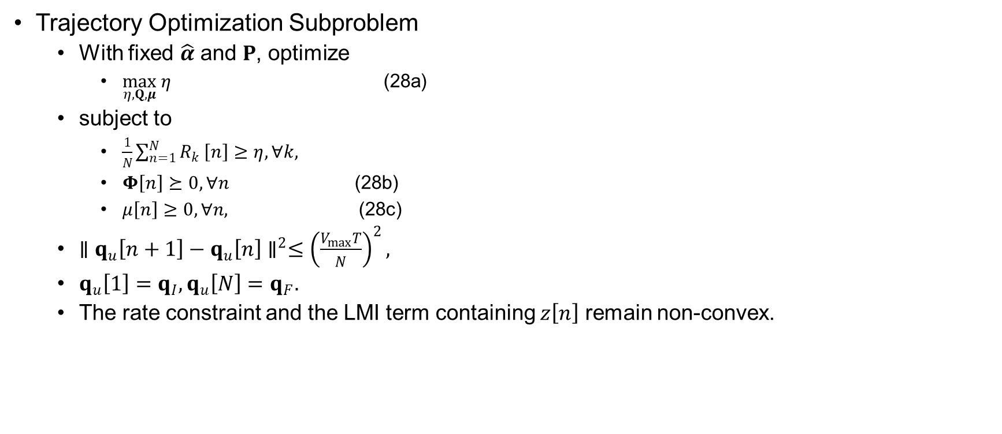
Covert Rate Maximization
Trajectory Optimization Subproblem
  With fixed $\hat{α}$ and $P$, optimize
    $\max_{η,Q,μ} η$ (28a)
  subject to
    $\frac{1}{N}\sum_{n=1}^{N}{R_{k}}\left[n\right]≥η, ∀k,$
    $Φ\left[n\right]⪰0, ∀n$ (28b)
    $μ\left[n\right]≥0, ∀n,$ (28c)
  $∥q_{u}\left[n+1\right]−q_{u}\left[n\right]∥^{2}≤{\left(\frac{V_{max}T}{N}\right)}^{2},$
  $q_{u}\left[1\right]=q_{I}, q_{u}\left[N\right]=q_{F}.$
  The rate constraint and the LMI term containing $z\left[n\right]$ remain non-convex.

Slide 53
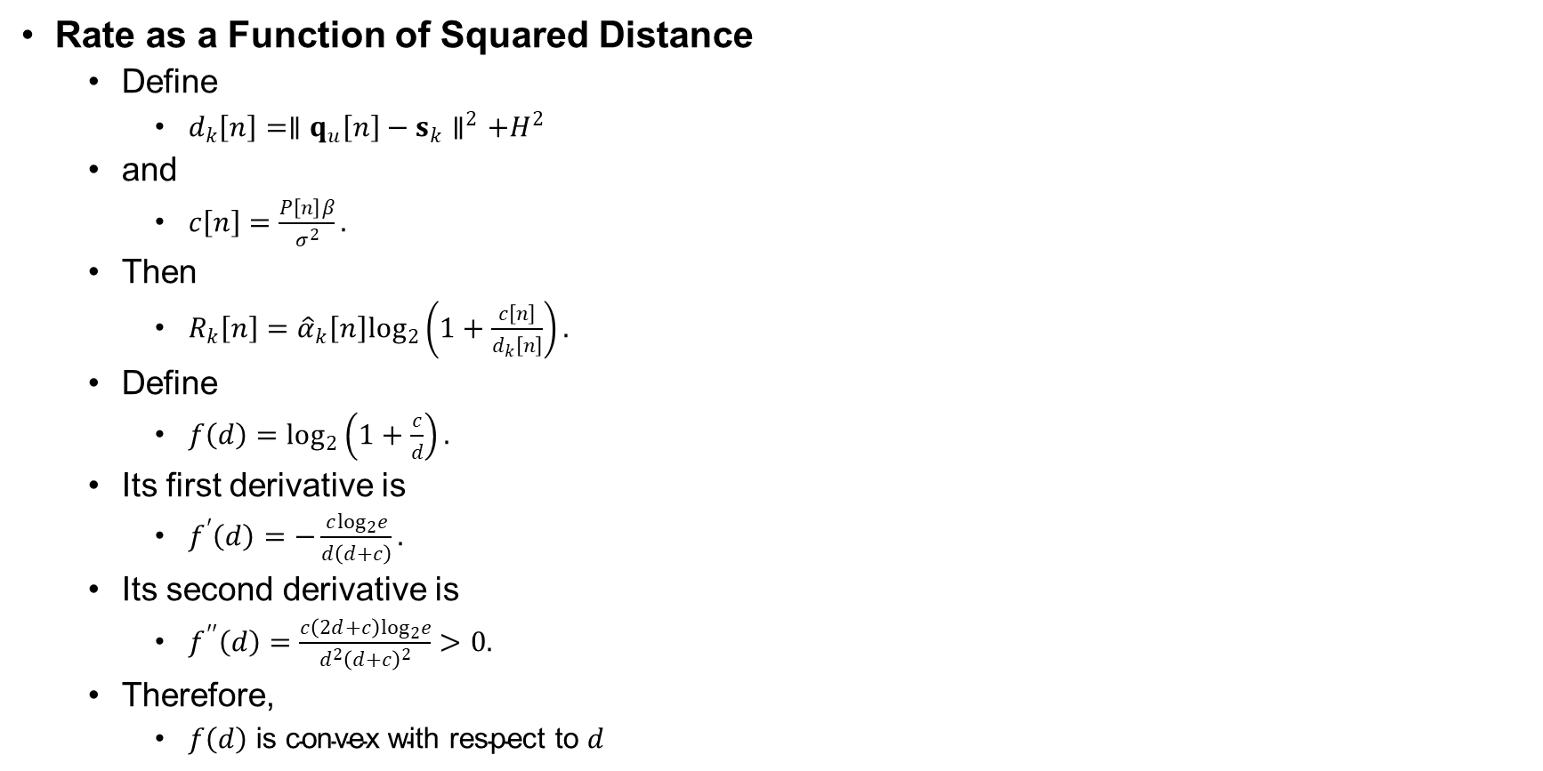
Covert Rate Maximization
Rate as a Function of Squared Distance
  Define
    $d_{k}\left[n\right]=∥q_{u}\left[n\right]−s_{k}∥^{2}+H^{2}$
  and
    $c\left[n\right]=\frac{P\left[n\right]β}{σ^{2}}.$
  Then
    $R_{k}\left[n\right]={\hat{α}}_{k}\left[n\right]\log_{2}\left(1+\frac{c\left[n\right]}{d_{k}\left[n\right]}\right).$
  Define
    $f\left(d\right)=\log_{2}\left(1+\frac{c}{d}\right).$
  Its first derivative is
    $f^{′}\left(d\right)=−\frac{c\log_{2}e}{d\left(d+c\right)}.$
  Its second derivative is
    $f^{′′}\left(d\right)=\frac{c\left(2d+c\right)\log_{2}e}{d^{2}{\left(d+c\right)}^{2}}>0.$
  Therefore,
    $f\left(d\right) \text{is} \text{convex} \text{with} \text{respect} \text{to} d$

Slide 54
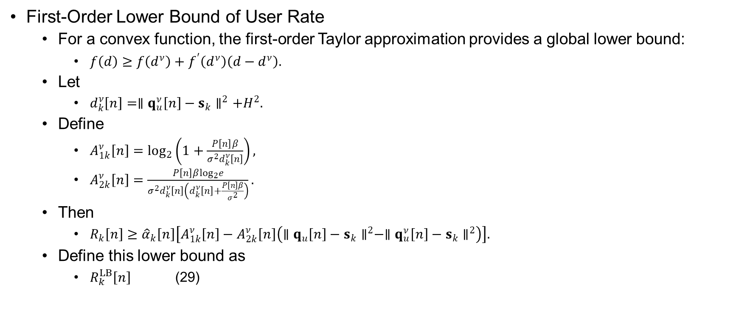
Covert Rate Maximization
First-Order Lower Bound of User Rate
  For a convex function, the first-order Taylor approximation provides a global lower bound:
    $f\left(d\right)≥f\left(d^{ν}\right)+f^{′}\left(d^{ν}\right)\left(d−d^{ν}\right).$
  Let
    $d_{k}^{ν}\left[n\right]=∥q_{u}^{ν}\left[n\right]−s_{k}∥^{2}+H^{2}.$
  Define
    $A_{1k}^{ν}\left[n\right]=\log_{2}\left(1+\frac{P\left[n\right]β}{σ^{2}d_{k}^{ν}\left[n\right]}\right),$
    $A_{2k}^{ν}\left[n\right]=\frac{P\left[n\right]β\log_{2}e}{σ^{2}d_{k}^{ν}\left[n\right]\left(d_{k}^{ν}\left[n\right]+\frac{P\left[n\right]β}{σ^{2}}\right)}.$
  Then
    $R_{k}\left[n\right]≥{\hat{α}}_{k}\left[n\right]\left[A_{1k}^{ν}\left[n\right]−A_{2k}^{ν}\left[n\right]\left(∥q_{u}\left[n\right]−s_{k}∥^{2}−∥q_{u}^{ν}\left[n\right]−s_{k}∥^{2}\right)\right].$
  Define this lower bound as
    $R_{k}^{LB}\left[n\right]$ (29)

Slide 55
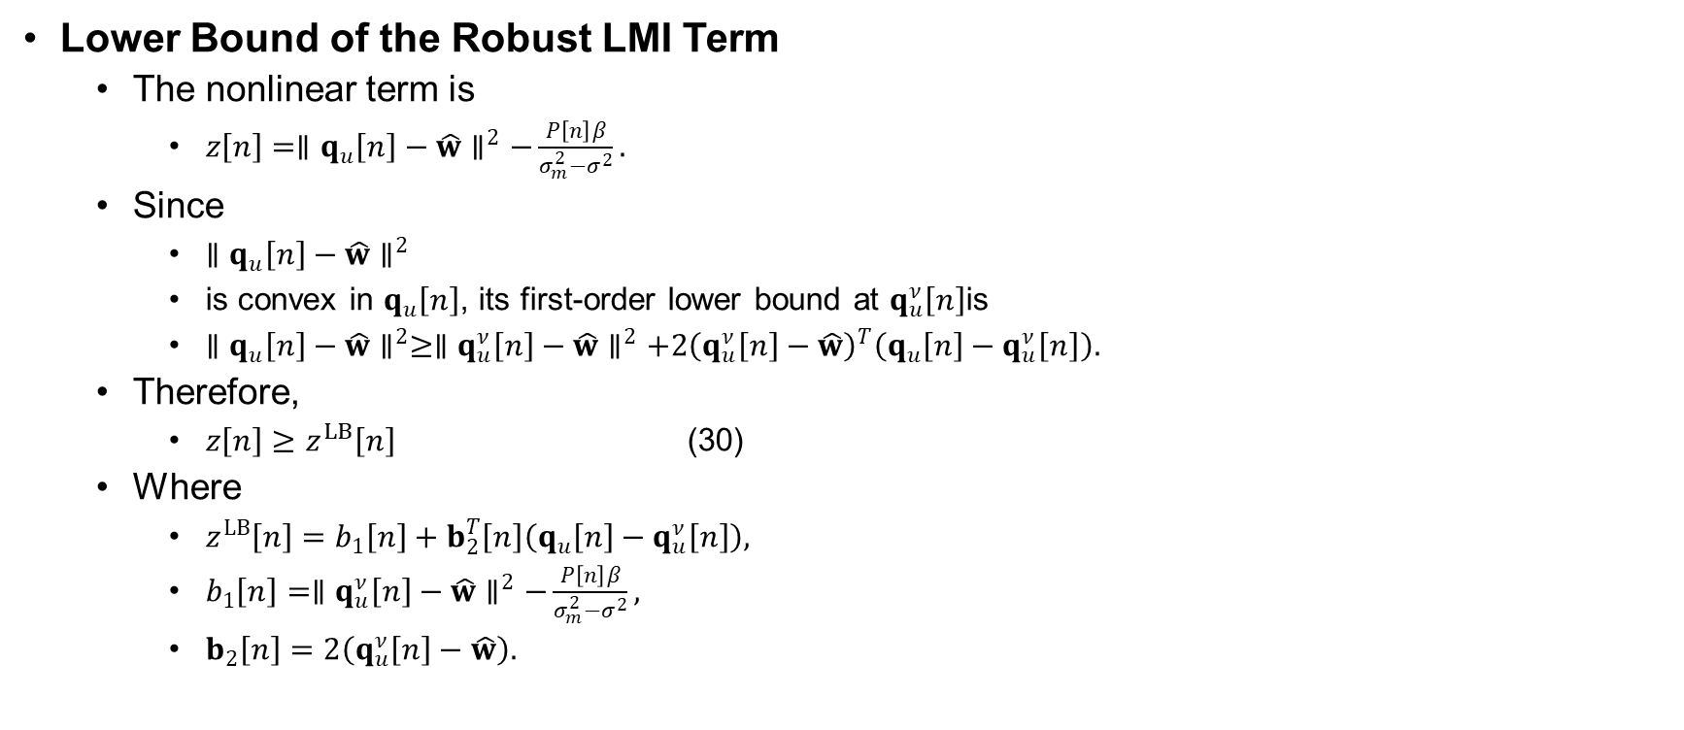
Covert Rate Maximization
Lower Bound of the Robust LMI Term
  The nonlinear term is
    $z\left[n\right]=∥q_{u}\left[n\right]−\hat{w}∥^{2}−\frac{P\left[n\right]β}{σ_{m}^{2}−σ^{2}}.$
  Since
    $∥q_{u}\left[n\right]−\hat{w}∥^{2}$
    is convex in $q_{u}\left[n\right]$, its first-order lower bound at $q_{u}^{ν}\left[n\right]$is
    $∥q_{u}\left[n\right]−\hat{w}∥^{2}≥∥q_{u}^{ν}\left[n\right]−\hat{w}∥^{2}+2{\left(q_{u}^{ν}\left[n\right]−\hat{w}\right)}^{T}\left(q_{u}\left[n\right]−q_{u}^{ν}\left[n\right]\right).$
  Therefore,
    $z\left[n\right]≥z^{LB}\left[n\right]$ (30)
  Where
    $z^{LB}\left[n\right]=b_{1}\left[n\right]+b_{2}^{T}\left[n\right]\left(q_{u}\left[n\right]−q_{u}^{ν}\left[n\right]\right),$
    $b_{1}\left[n\right]=∥q_{u}^{ν}\left[n\right]−\hat{w}∥^{2}−\frac{P\left[n\right]β}{σ_{m}^{2}−σ^{2}},$
    $b_{2}\left[n\right]=2\left(q_{u}^{ν}\left[n\right]−\hat{w}\right).$

Slide 56
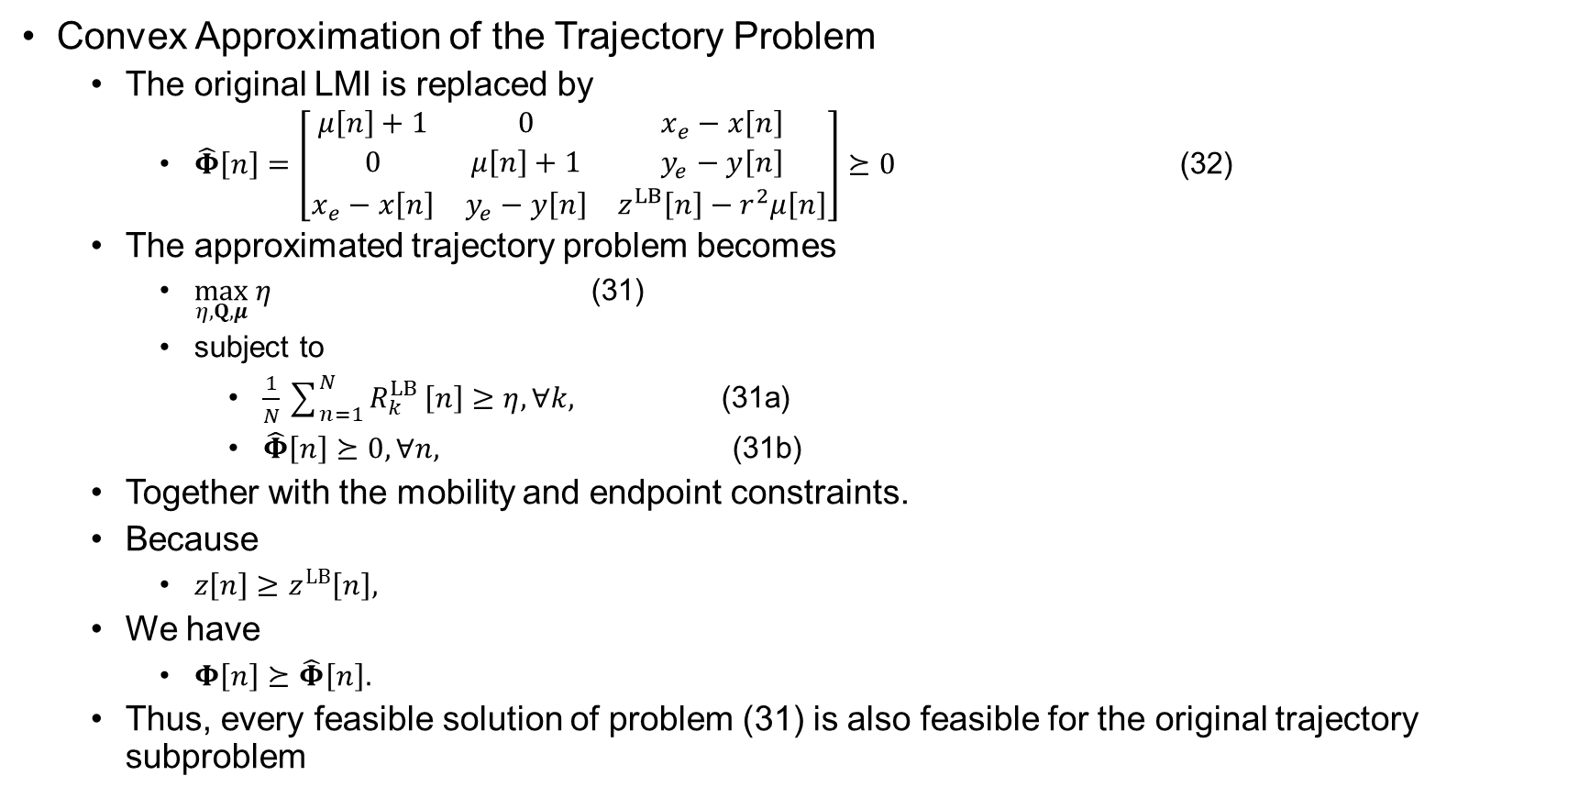
Covert Rate Maximization
Convex Approximation of the Trajectory Problem
  The original LMI is replaced by
    $\hat{Φ}\left[n\right]=\left[\begin{matrix}μ\left[n\right]+1 & 0 & x_{e}−x\left[n\right] \\ 0 & μ\left[n\right]+1 & y_{e}−y\left[n\right] \\ x_{e}−x\left[n\right] & y_{e}−y\left[n\right] & z^{LB}\left[n\right]−r^{2}μ\left[n\right]\end{matrix}\right]⪰0$ (32)
  The approximated trajectory problem becomes
    $\max_{η,Q,μ} η$ (31)
    subject to
      $\frac{1}{N}\sum_{n=1}^{N}{R_{k}^{LB}}\left[n\right]≥η, ∀k,$ (31a)
      $\hat{Φ}\left[n\right]⪰0, ∀n,$ (31b)
  Together with the mobility and endpoint constraints.
  Because
    $z\left[n\right]≥z^{LB}\left[n\right],$
  We have
    $Φ\left[n\right]⪰\hat{Φ}\left[n\right].$
  Thus, every feasible solution of problem (31) is also feasible for the original trajectory subproblem

Slide 57
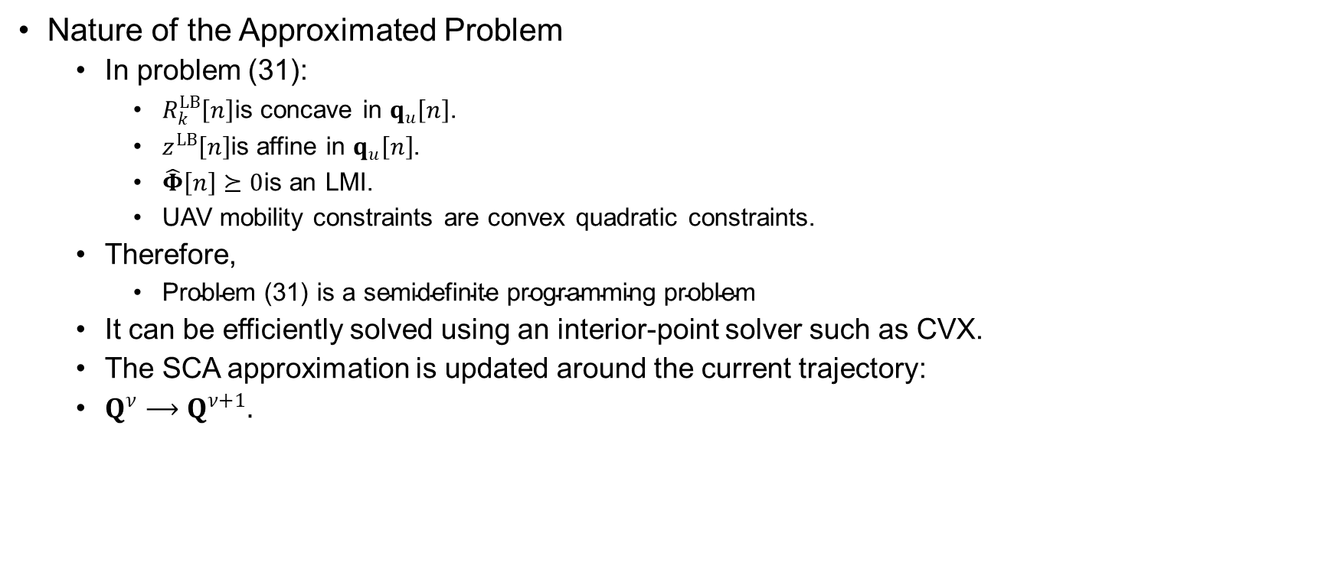
Covert Rate Maximization
Nature of the Approximated Problem
  In problem (31):
    $R_{k}^{LB}\left[n\right]$is concave in $q_{u}\left[n\right]$.
    $z^{LB}\left[n\right]$is affine in $q_{u}\left[n\right]$.
    $\hat{Φ}\left[n\right]⪰0$is an LMI.
    UAV mobility constraints are convex quadratic constraints.
  Therefore,
    $\text{Problem}\text{ (31) }\text{is} \text{a} \text{semidefinite} \text{programming} \text{problem}$
  It can be efficiently solved using an interior-point solver such as CVX.
  The SCA approximation is updated around the current trajectory:
  $Q^{ν}⟶Q^{ν+1}.$

Slide 58

Covert Rate Maximization
$θ$-Assisted Power Constraint
  At iteration $ν$, the power constraint is tightened as
    $P\left[n\right]≤θ^{ν}\frac{\left(σ_{m}^{2}−σ^{2}\right)\left(D\left[n\right]+H^{2}\right)}{β},$ (33)
  Where
    $0<θ^{ν}≤1.$
  Initially,
    $θ^{ν}<1,$
  Which leaves a safety margin in the covertness constraint.
  The parameter is gradually increased:
    $θ^{ν+1}=θ^{ν}+θ_{\text{step}},$
  Where
    $θ_{\text{step}}=\frac{1−θ^{0}}{I_{m}}.$
  At the final iteration,
    $θ^{ν}=1.$

Slide 59

Covert Rate Maximization
Modified Linearization Under $θ^{ν}$
  Under the $θ$-assisted method, the power constraint implies
    $\frac{P\left[n\right]β}{\left(σ_{m}^{2}−σ^{2}\right)θ^{ν}}≤D\left[n\right]+H^{2}.$
  Therefore, the constant term in the lower bound is modified as
    $b_{1}\left[n\right]=∥q_{u}^{ν}\left[n\right]−\hat{w}∥^{2}−\frac{P\left[n\right]β}{\left(σ_{m}^{2}−σ^{2}\right)θ^{ν}}$ (34)
  The lower-bound expression becomes
    $z^{LB}\left[n\right]=b_{1}\left[n\right]+2{\left(q_{u}^{ν}\left[n\right]−\hat{w}\right)}^{T}\left(q_{u}\left[n\right]−q_{u}^{ν}\left[n\right]\right).$
  The slack created by $θ^{ν}<1$allows the trajectory to move without immediately violating covertness.

Slide 60

Covert Rate Maximization
Complete Iterative Algorithm
  Initialization
    Set
    $ν=0,$
    and initialize feasible
    $P^{ν}, Q^{ν}, 0<θ^{ν}≤1.$
  Iteration
    Solve problem (24):
      ${\hat{α}}^{ν+1}=\arg{\max_{\hat{α},η}}η$
    Solve problem (27) using constraint (33):
      $P^{ν+1}=\arg{\max_{P,η}}η$
  Update:
    $θ^{ν+1} =\min\left(1,θ^{ν}+θ_{step}\right)$
    Solve problem (31):
      $Q^{ν+1}=\arg{\max_{Q,μ,η}}η.$
  Set
    $ν←ν+1.$
    Repeat until the objective improvement is sufficiently small and $θ^{ν}=1$.

Slide 61

Covert Rate Maximization
Reconstruction of Binary Scheduling
  After convergence, the relaxed scheduling variables satisfy
    $0≤{\hat{α}}_{k}\left[n\right]≤1.$
  They are converted into binary variables using
    $α_{k}\left[n\right]=\left\{\begin{matrix}1, & k=\arg{\max_{i∈\left\{1 , … , K\right\}}}{\hat{α}}_{i}\left[n\right], \\ 0, & \text{otherwise}.\end{matrix}\right.$ (35)
  Thus, each slot is assigned to the user with the largest relaxed scheduling value.
  The TDMA condition is automatically satisfied:
    $\sum_{k=1}^{K}{α_{k}}\left[n\right]=1$
  for an active transmission slot.

Slide 62

Covert Rate Maximization
Convergence Analysis
  Each subproblem maximizes the same objective $η$while fixing the remaining variable blocks.
  Therefore,
    $η^{ν+1}≥η^{ν}.$
  The objective sequence is non-decreasing:
    $η^{0}≤η^{1}≤η^{2}≤⋯ .$
  The achievable rate is upper-bounded because
    $P\left[n\right]≤P_{max}$
  and all channel gains are finite.
  Hence,
    $η^{ν}≤η_{max}<∞.$
  A monotonic and upper-bounded sequence converges. Therefore, Algorithm 1 converges to a stationary or locally optimal solution.

Slide 63

Covert Rate Maximization
Complexity and Final Remarks
  At each BCD iteration, the algorithm solves:
    One linear scheduling problem
    One convex power-allocation problem
    One semidefinite trajectory problem
    The computational complexity is approximately
    $\boxed{𝒪\left({\left(KN\right)}^{3.5}\right)}$
    per iteration.
Key Characteristics
    Exploits TDMA scheduling
    Controls transmit power under worst-case covertness
    Designs a physically feasible UAV trajectory
    Uses SCA to handle non-convex trajectory constraints
    Uses $θ$to preserve trajectory-update feasibility
    Converges, but global optimality is not guaranteed
    $\text{The} \text{algorithm} \text{provides} \text{an} \text{efficient} \text{locally} \text{optimal} \text{solution} \text{to} \text{Problem}\text{ (9)}$

